Slide 1
Productivity Training
Support Link

Slide 3
Today’s Objective:
Set you up for success!
Tips and advice on
Time management
Creating documents
Collaborating on documents
File management
Group activities (time permitting)

Slide 5
Maximize
OUTPUT
Maximize
QUALITY

Slide 7
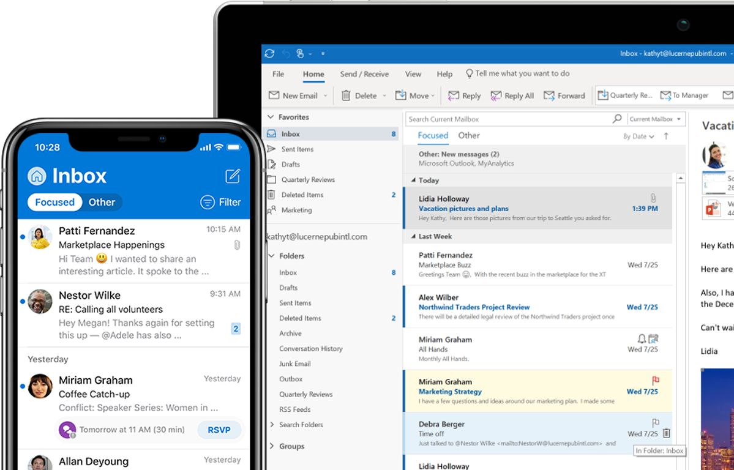
It’s important to use your
student email account!
Support Link

Slide 8
WHAT IS YOUR
MOST VALUABLE
RESOURCE?

Slide 9
TIME

Slide 10
Time Management

Slide 11
Why is Time Management important?
What are the negative consequences of bad time management?
What are the positive benefits of great time management?

Slide 12
To Do Lists (Checklists)
So we don’t forget!
So we can organize our tasks
Organizing relieves stress
So we can priorize our tasks
So we can schedule our tasks
So we can delegate (where appropriate)
So we can manage expectations

Slide 13
Urgent and
Important
Not Urgent
but
Important
Urgent
but not
Important
Not Urgent
and not
Important

Slide 14
We tend to do the easy and/or enjoyable!
Urgent and
Important
Not Urgent
but
Important
DO FIRST
DO NEXT
Urgent
but not
Important
Not Urgent
and not
Important
DELEGATE
ELIMINATE

Slide 15
Scheduling Your Time
Plan the URGENT and IMPORTANT first
Plan the IMPORTANT but not URGENT second
Schedule them early
Allow ample time

Slide 16
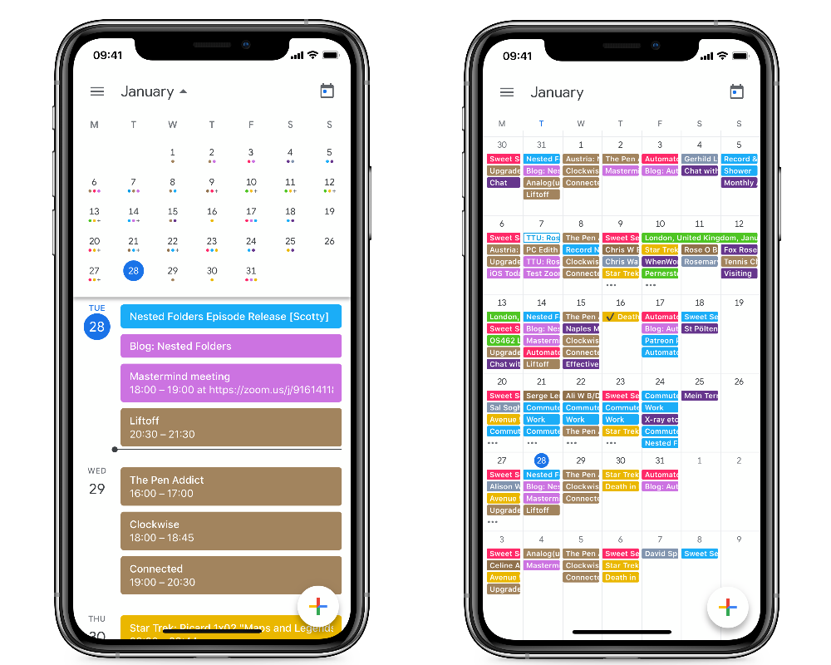
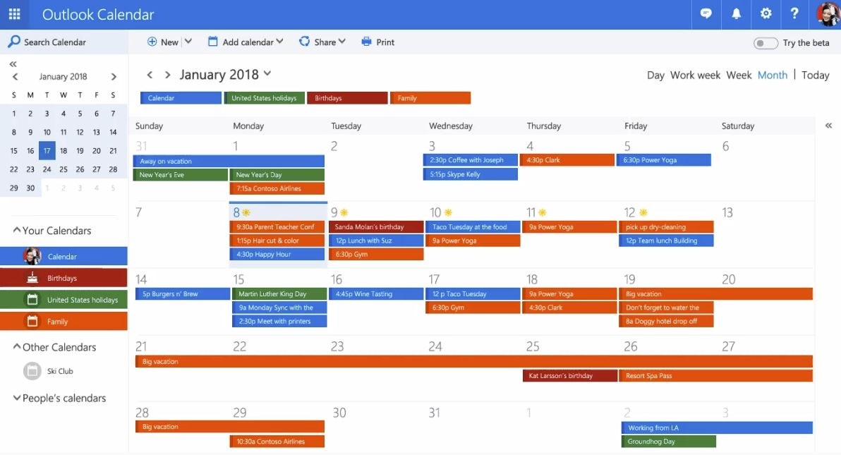
Digital Calendar
Support Link

Slide 17
Minimizing Distractions

Slide 18
Focus on one thing at a time

Slide 20
BREAK THE
ADDICTION

Slide 21
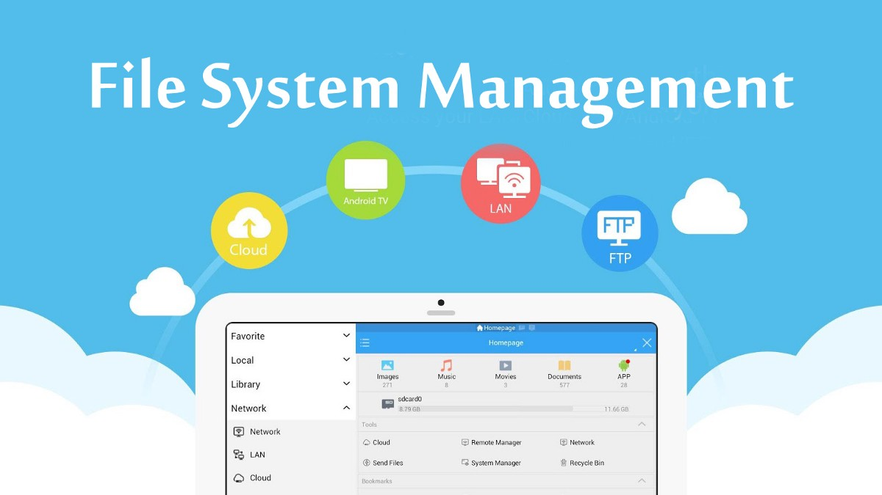

Slide 22
Cloud Storage
Cloud Computing
Servers

Slide 23
File Folder Management
Use your OneDrive to backup your files!
Create a folder per course
You may need sub-folders per course
Use descriptive file names
Support Link

Slide 24
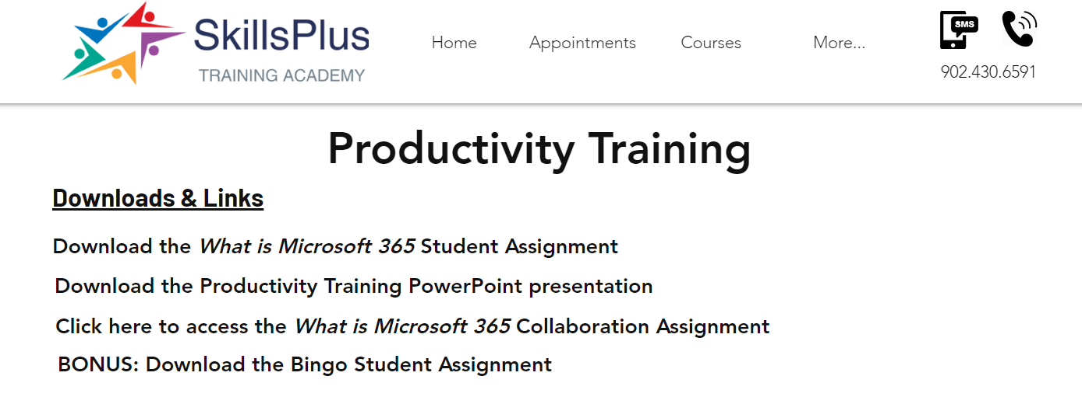
Skillsplus.ca/productivity

Slide 26
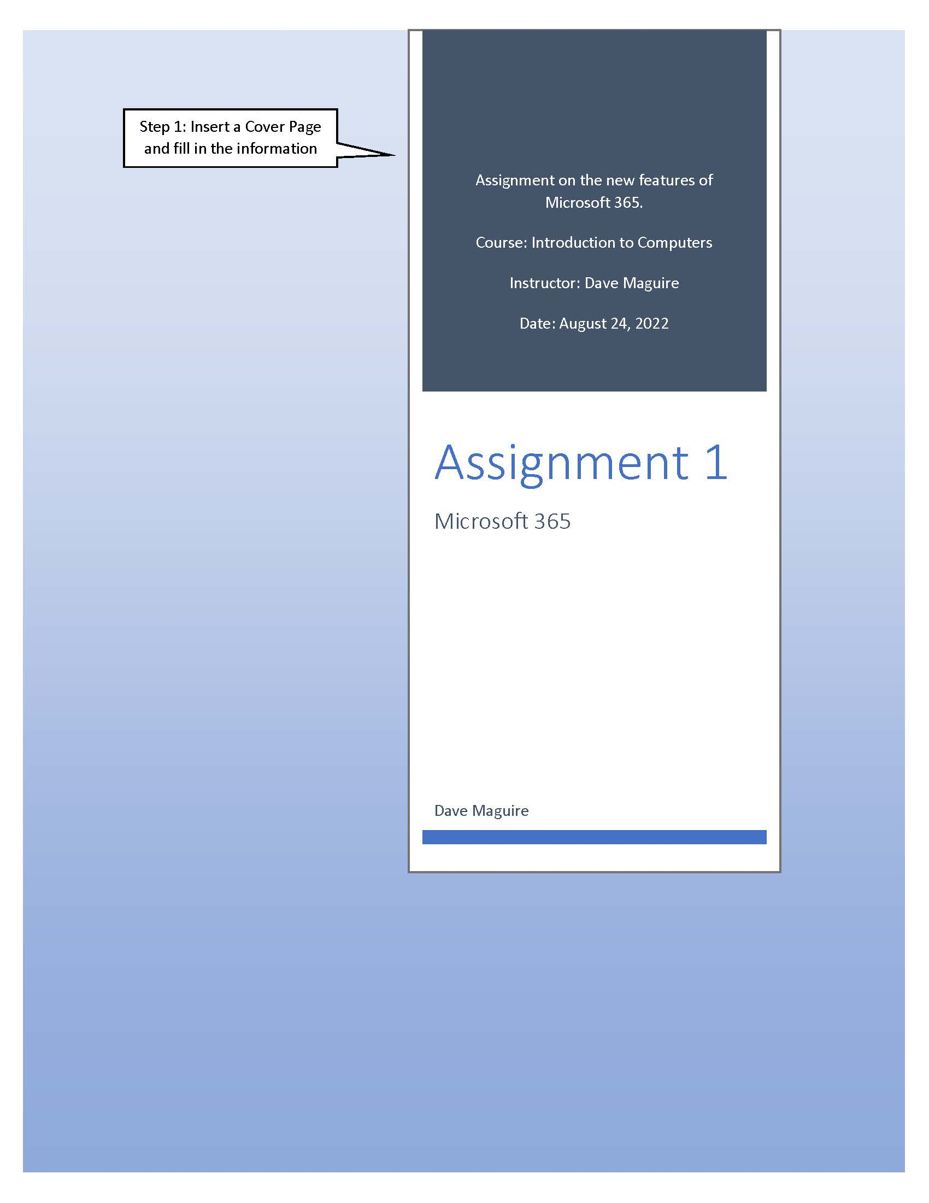
Use Word’s cover pages
Please download the Student Word Assignment from skillsplus.ca/productivity
Support Link

Slide 27
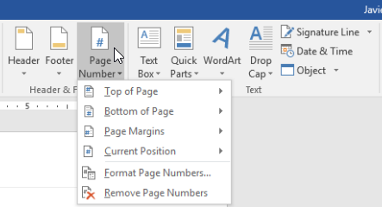
Use Word’s automatic
page numbering
Best format is ‘Page x of y’ (example: Page 2 of 8)
Support Link

Slide 28
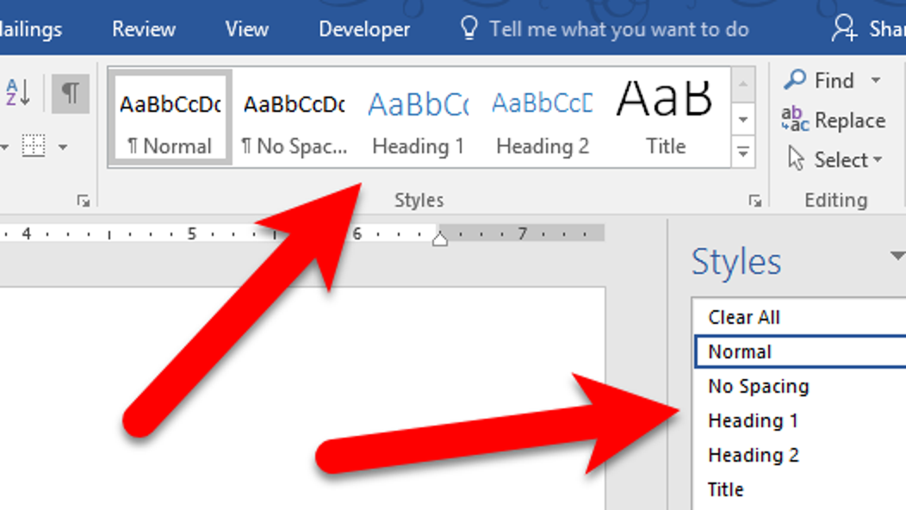
Use Heading Styles for your titles
You can customize them
Support Link

Slide 29
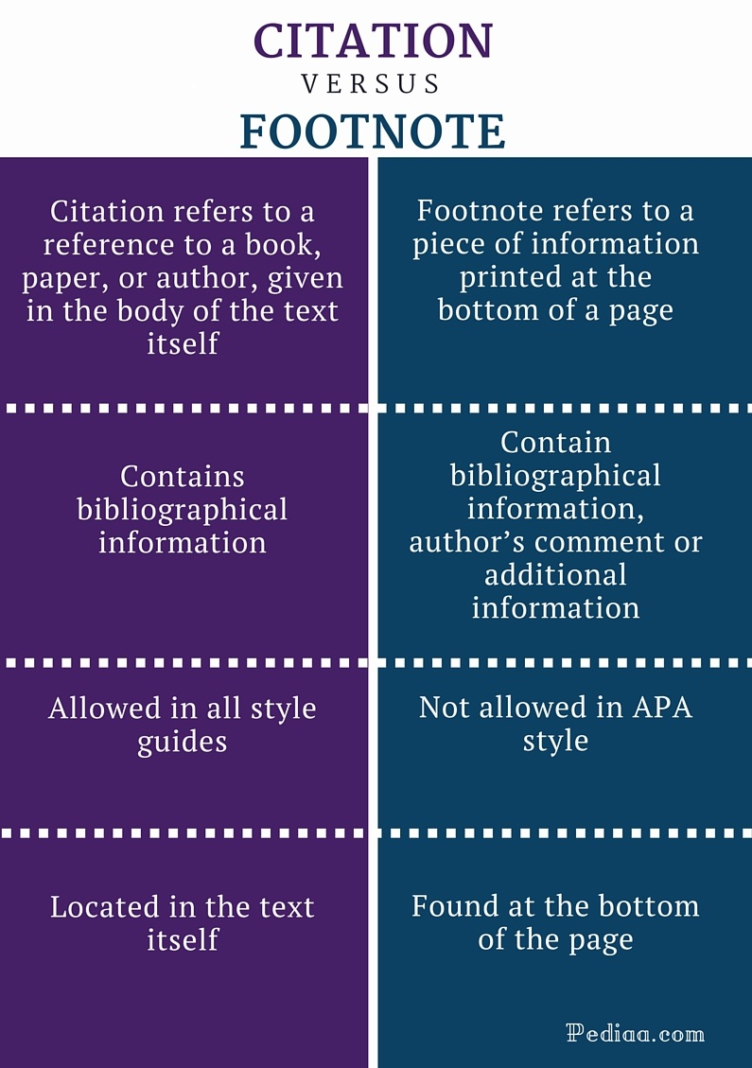

Slide 30
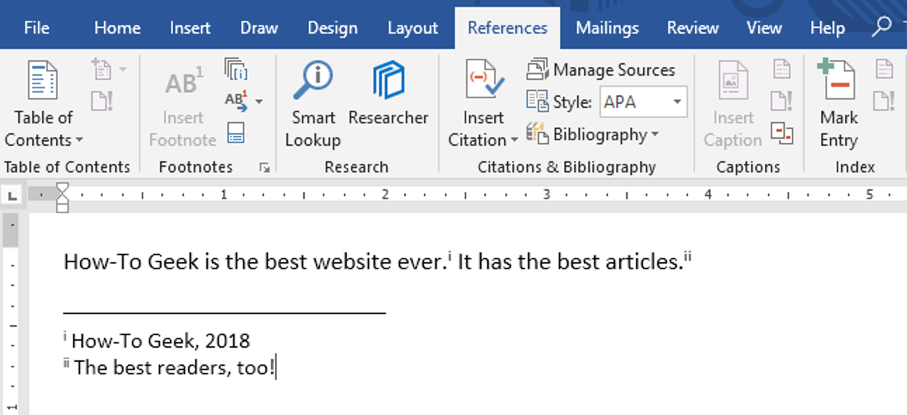
Support Link
Use Word to insert your Footnotes

Slide 31
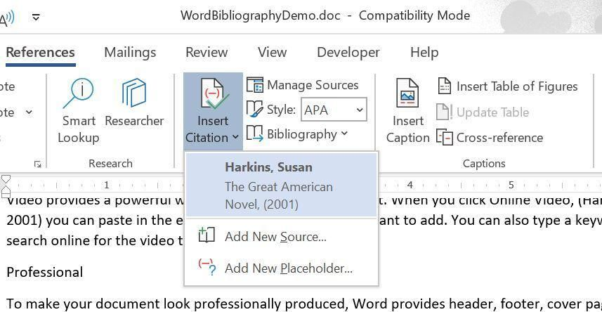
Support Link
Use Word to insert your Citations

Slide 32
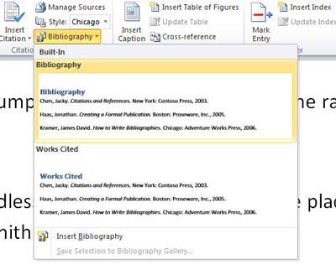
Use Word’s Bibliography
It links to your Citations!
Support Link

Slide 33
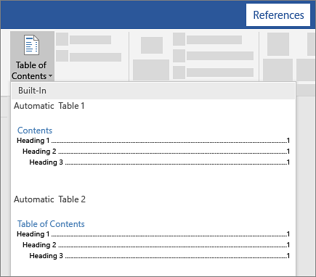
Use Word’s Table of Contents
It links to your Heading Styles and Page Numbers!
Support Link

Slide 34
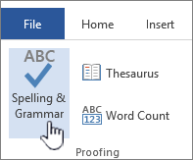
Use Word’s Spelling & Grammar
Support Link

Slide 35
File Collaboration
Team members in different locations can all contribute to writing in the same document at the same time
Document must be saved in your OneDrive
Document is then SHARED with the team

Slide 36
Group Activities
You will likely be placed on a team for a group activity at some point
This can be stressful
Be constructive, not destructive!
Meet your responsibilities
Always be on time and show up to meetings
Collaborate vs conflict

