Slide 2
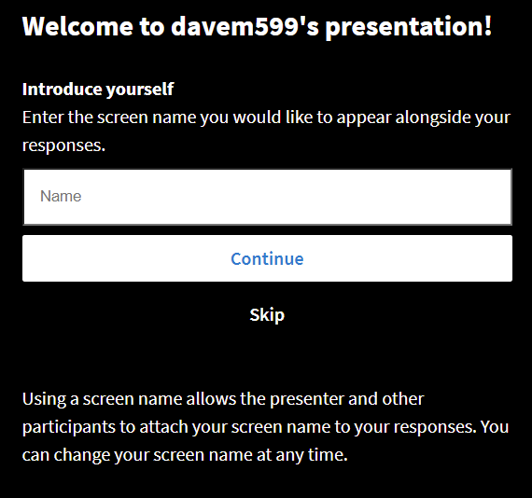
Please go to this web address to submit responses
Go to
pollev.com/davem599
on your phone,
tablet or computer
Select Continue

Slide 3
Managing Human Resources: Conflicting Objectives
Employees want
High wages
Job Security
Predictable hours and schedule
Minimal effort
Businesses want
Low costs
Job Flexibility
Flexible hours and schedule
Maximum effort

Slide 5
We must fight for our rights

Slide 6
We must protect worker’s rights

Slide 7
Our business is better if we treat our employees right!

Slide 8
What is the human resource process?
(or what does the HR Department do?)

Slide 9
Notes:
LiveSlide https://jamboard.google.com/d/1xYq5IKwFqpQZ34-t9i_ad9srOTeS1WuXtTtbEQ6J_RU/edit?usp=sharing

Slide 10
Plan
Recruit
Hire
Orient
Train
Evaluate
Develop
Depart
Attract candidates
(internal & external)
Job postings
Screen
Interview
Reference checks
Determine needs
Create job specifications
Establish compensation
Offer
Negotiate
Acceptance
Ongoing administration begins
Essential paperwork
Tours
Introductions
Resources
Company Standards
(e.g. policies)
Identify skills gaps
Provide training
Company processes
Skills gaps
Voluntary
departure
Retirement
Dismissal
Exit interview
Periodic evaluations
Feedback
Action plans
Transfers
Promotions
Job enrichment

Slide 11
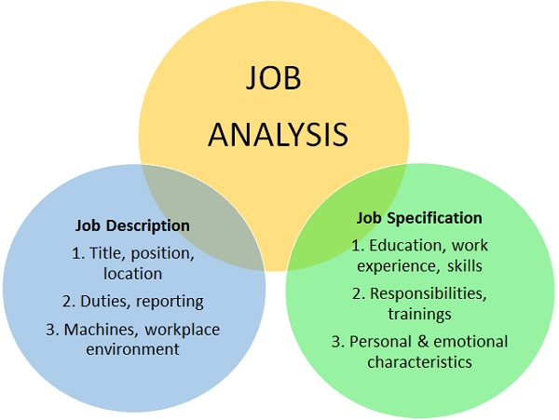
PLANNING

Slide 12
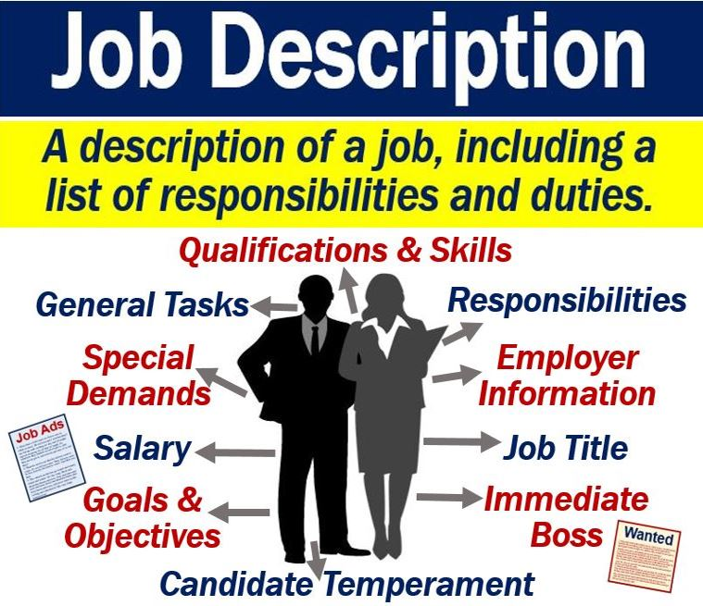

Slide 13
Pay level
Pay structure
Benefits

Slide 15
Internal vs External
Post job ads
Use recruitment agencies
Referrals

Slide 16
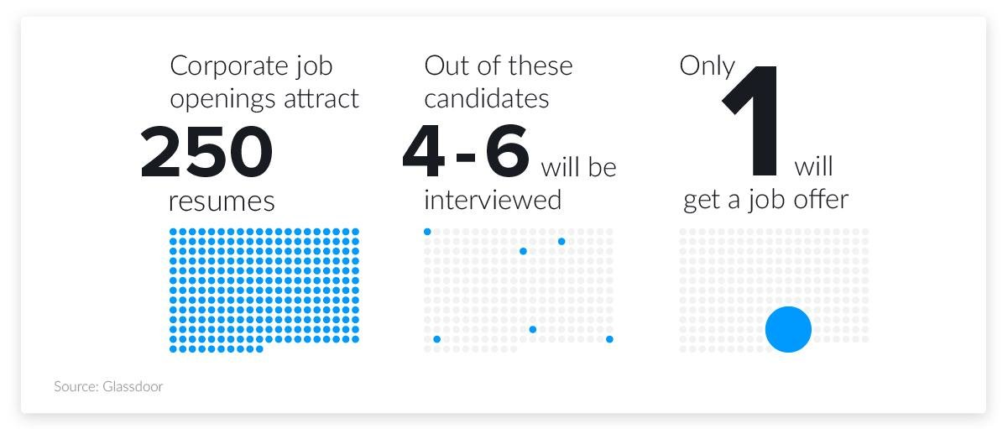
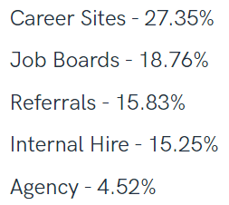

Slide 17
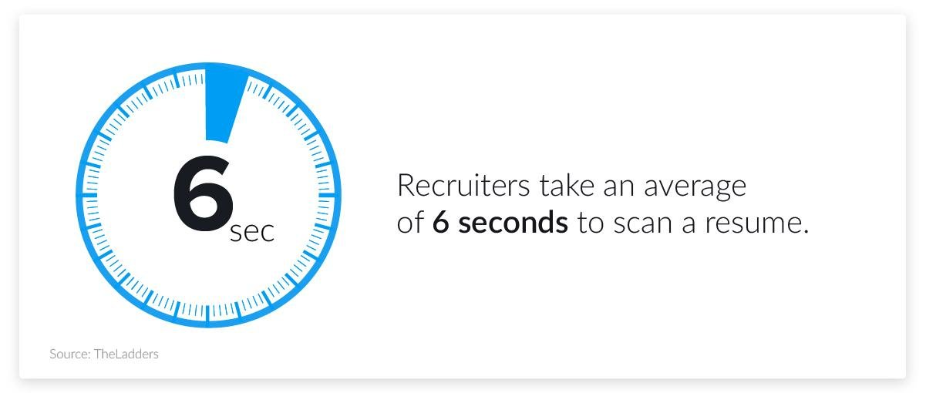
Screening

Slide 19
Structured vs
Unstructured

Slide 20
Ability tests
Personality tests
Performance simulation

Slide 22
Selection

Slide 26
Only 12% of employees agree that their company does a good job of onboarding new employees. (State of the American Workplace Report Gallup 2017)

Slide 27
Skills gaps
Online
E-learning
On-the-job
Mentoring
Diversity

Slide 28
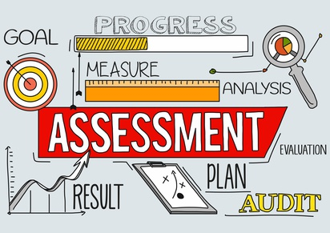
Traits
Behaviour
Results

Slide 33
Notes:
Poll Title: Do not modify the notes in this section to avoid tampering with the Poll Everywhere activity. More info at polleverywhere.com/support What are the positive benefits of great HR? https://www.polleverywhere.com/discourses/YL1wDi6OeYIEn9CDUqdyt

Slide 34
Positive Benefits
Less turnover, better retention
Fosters employee happiness, loyalty
High job satisfaction
Boosts productivity, gets better results
Better, more consistent quality
Lower costs – higher profit
Influences on pay, promotion, job design
Less theft and corporate sabotage
Better corporate reputation
Attracts great people that want to work there

Slide 35
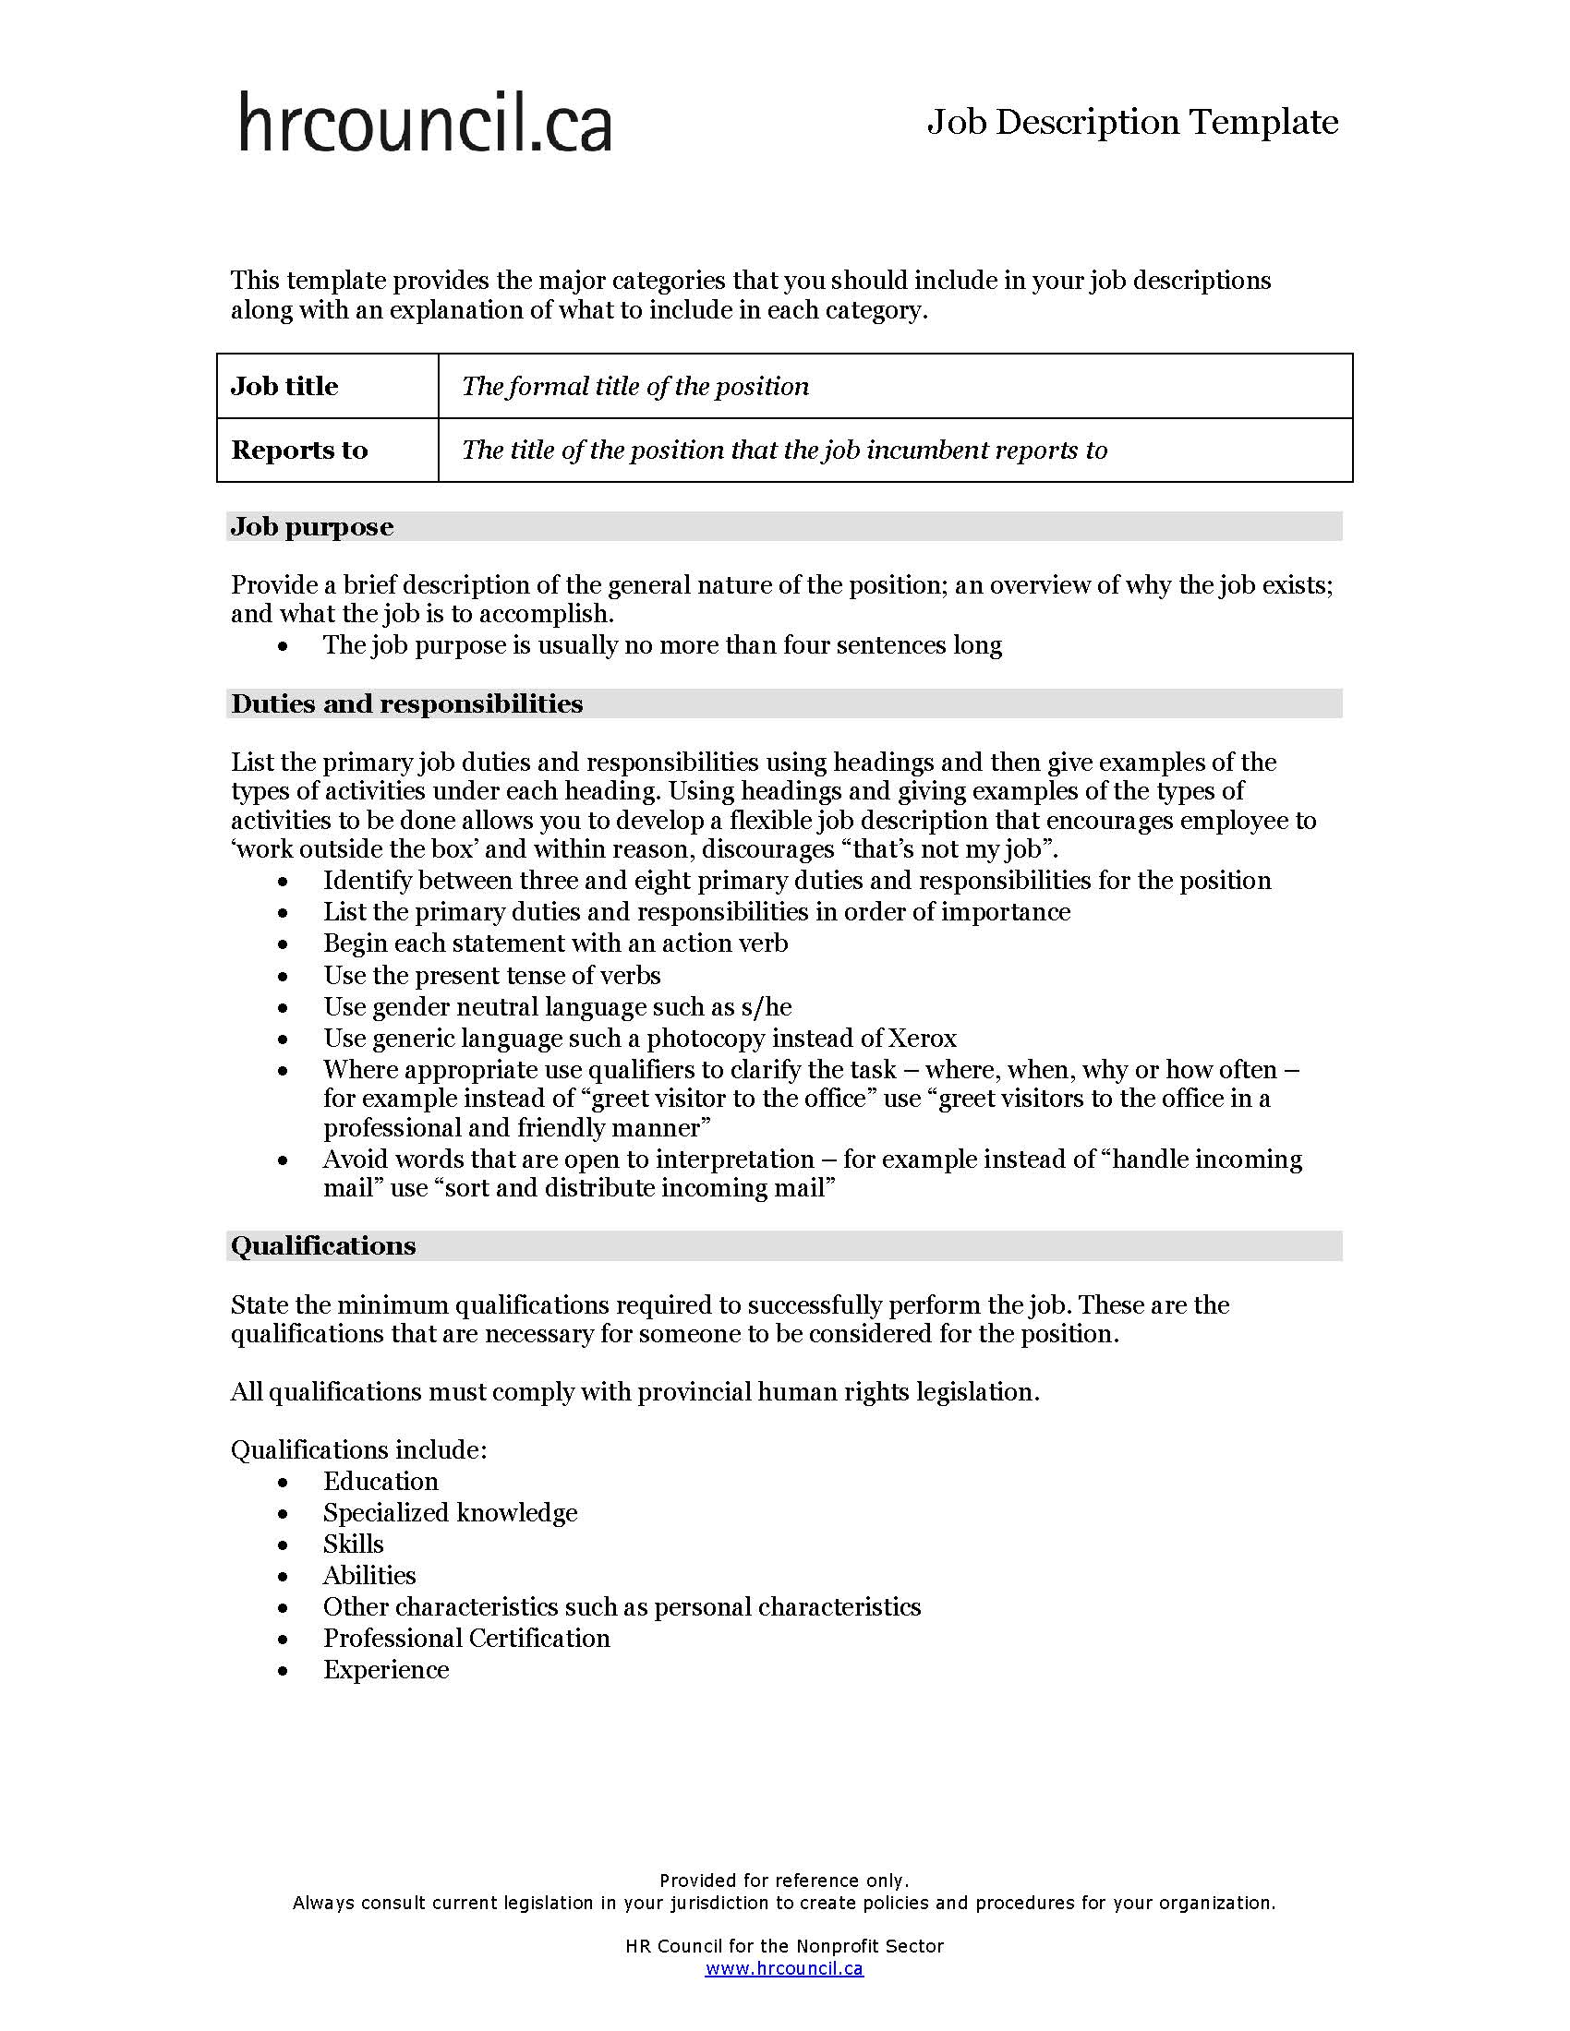

Slide 36
Notes:
Poll Title: Do not modify the notes in this section to avoid tampering with the Poll Everywhere activity. More info at polleverywhere.com/support What should be in a job description? https://www.polleverywhere.com/discourses/CcMVQkKgMFB4SLsek4VQM

Slide 37
Job Description
NO SURPRISES!!
Job Title
Reports to
Job purpose (brief description)
Duties and responsibilities
Qualifications
Working conditions
Physical requirements
Direct reports
Schedule and Hours Requirements
Compensation
Qualifications
Education
Specialized knowledge
Skills
Abilities
Other characteristics such as personal characteristics
Professional Certification
Experience

Slide 38
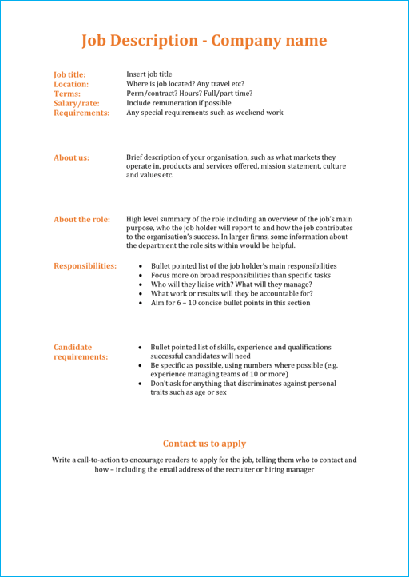
Plan
Recruit
Hire
Orient
Train
Evaluate
Develop
Depart

Slide 39
Plan
Recruit
Hire
Orient
Train
Evaluate
Develop
Depart

Slide 40
Plan
Recruit
Hire
Orient
Train
Evaluate
Develop
Depart

Slide 41
Plan
Recruit
Hire
Orient
Train
Evaluate
Develop
Depart

Slide 42
Plan
Recruit
Hire
Orient
Train
Evaluate
Develop
Depart

Slide 43
Plan
Recruit
Hire
Orient
Train
Evaluate
Develop
Depart

Slide 44
Plan
Recruit
Hire
Orient
Train
Evaluate
Develop
Depart

Slide 45
Plan
Recruit
Hire
Orient
Train
Evaluate
Develop
Depart

Slide 46
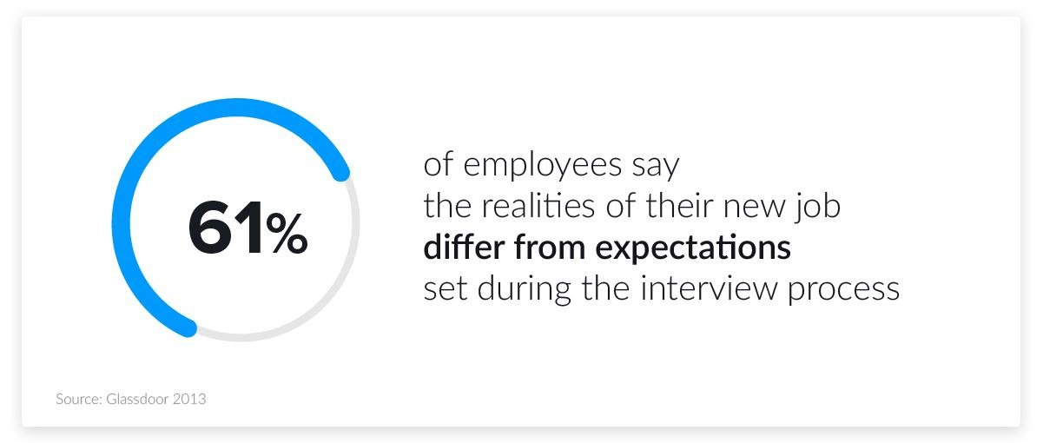
Plan
Recruit
Hire
Orient
Train
Evaluate
Develop
Depart
NO SURPRISES!!

Slide 48
Notes:
LiveSlide https://jamboard.google.com/d/1xYq5IKwFqpQZ34-t9i_ad9srOTeS1WuXtTtbEQ6J_RU/edit?usp=sharing

Slide 49
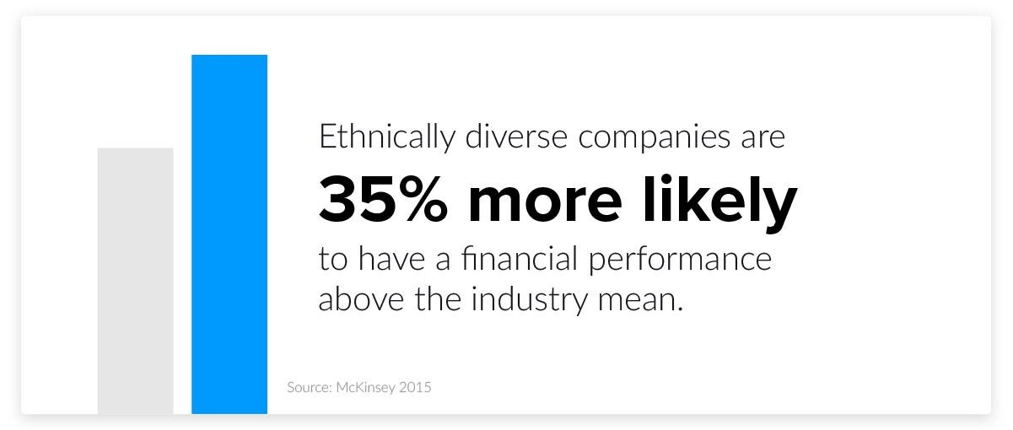
Diversity

Slide 50
Discrimination
Systemic vs Direct
Ethical considerations
Legal consequences

Slide 52
Steps to Eradicate Harassment
Develop and communicate a policy
Use a fair procedure to investigate
Take corrective action quickly
Provide education and training (especially to managers)

Slide 53
Employment Standards Act
Human Rights Commissions

Slide 54
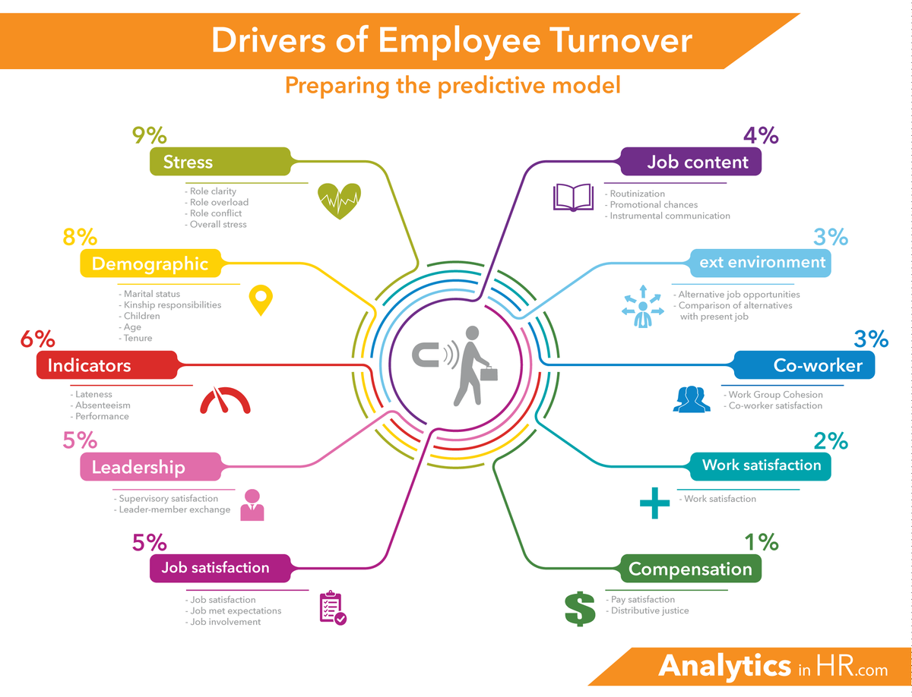
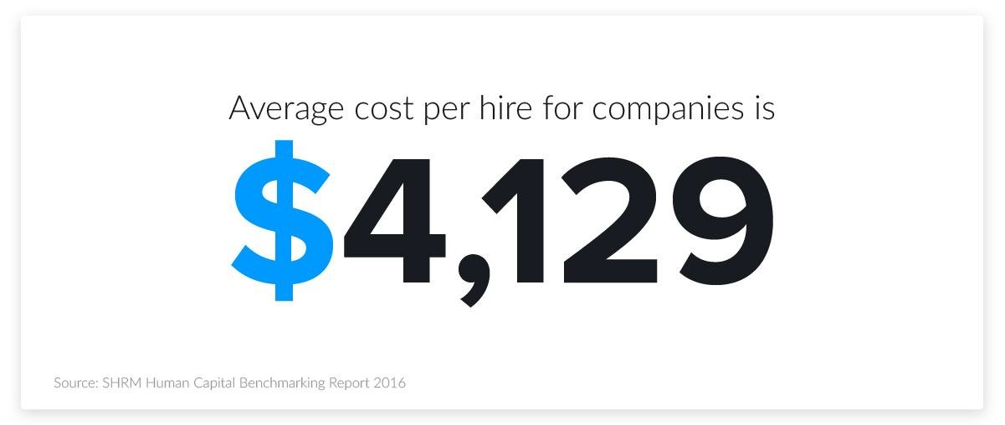

Slide 56
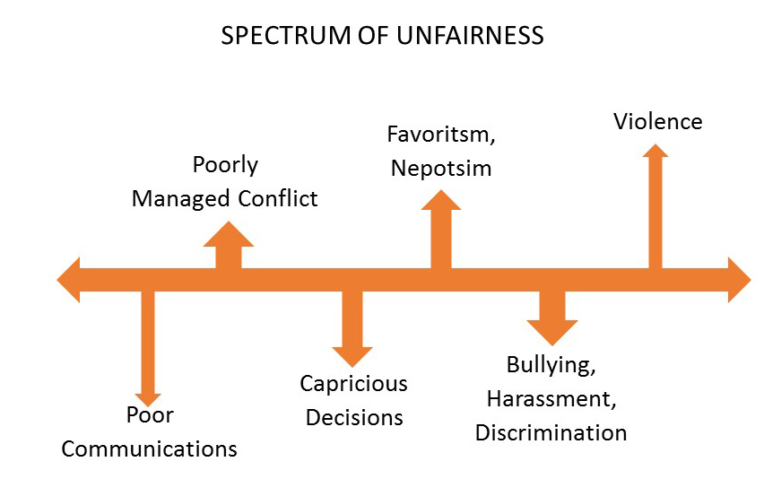
Fairness

Slide 57
Compliance: Navigate Laws and Regulations

Slide 60
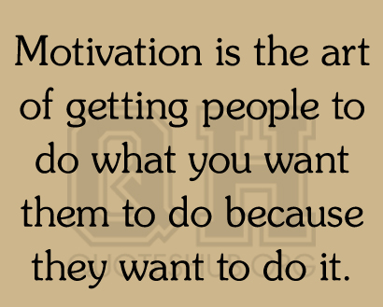
The Business Perspective

Slide 61
How can we motivate?
Compensation
Salary
Bonuses
Perks
Incentives
Working conditions
Promotions and new opportunities
Be constructive
Empower
Encourage work/life balance
Be flexible
Good communications
Be appreciative
Show support
Be encouraging
Recognize their efforts
Focus on development
Considerate ‘time off’

Slide 62
HINT: Emotional connection to your job and how much you like it
J O B
S A T I S F A C T I O N

Slide 63
