Slide 1
Roles of Packaging

Slide 4
Visual impact

Slide 5
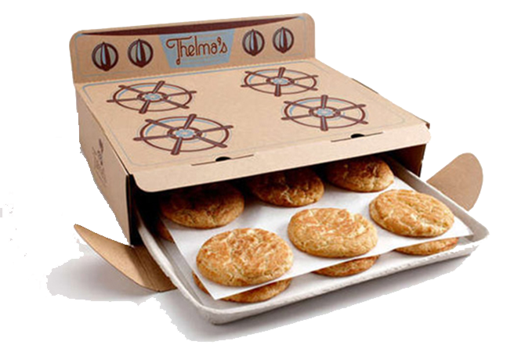
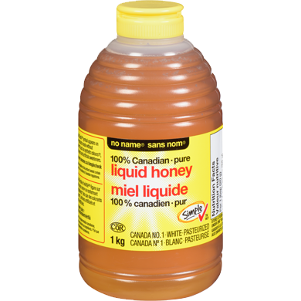
Support Brand Positioning

Slide 6
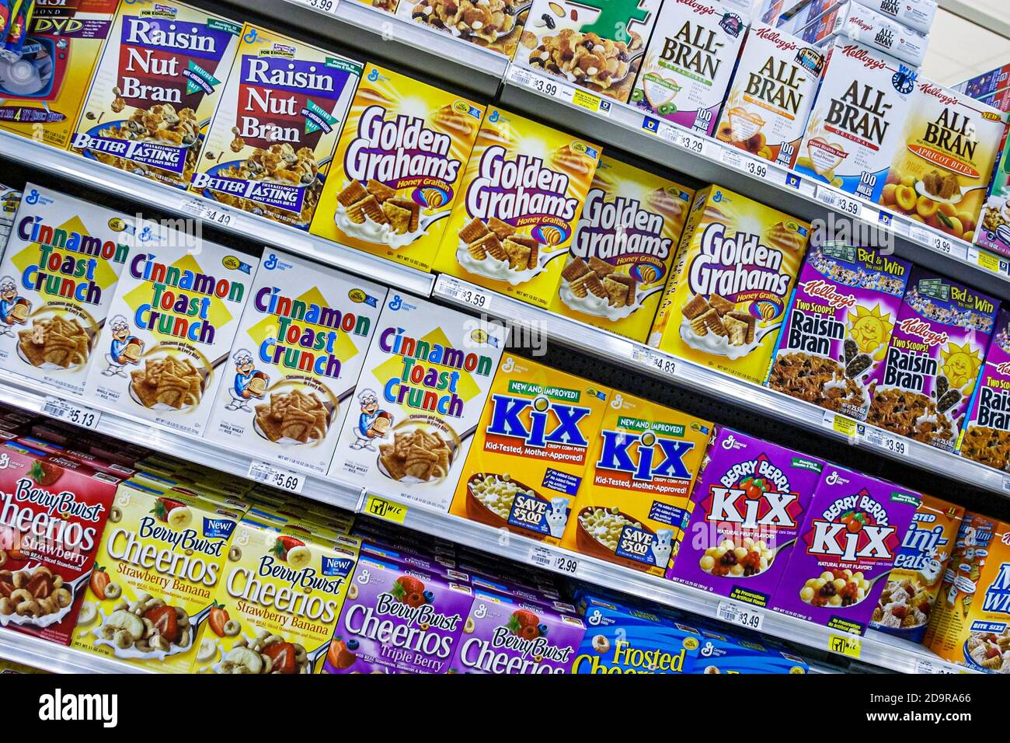
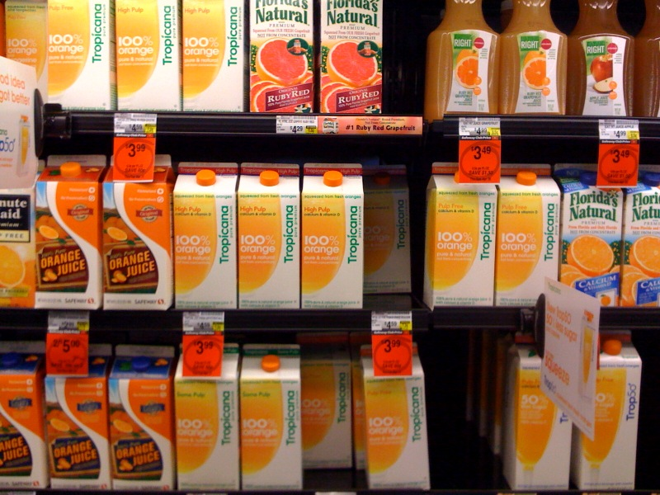
Shelf Impact

Slide 7
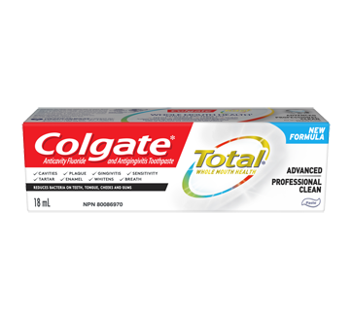
Space on shelf

Slide 8
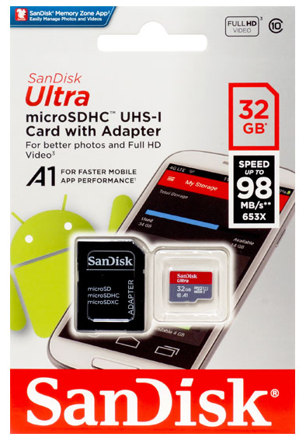
Protection

Slide 9
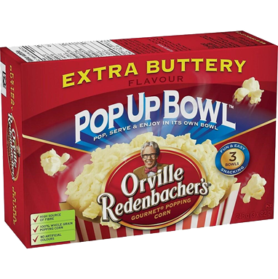
Functional ‘added value’

Slide 10
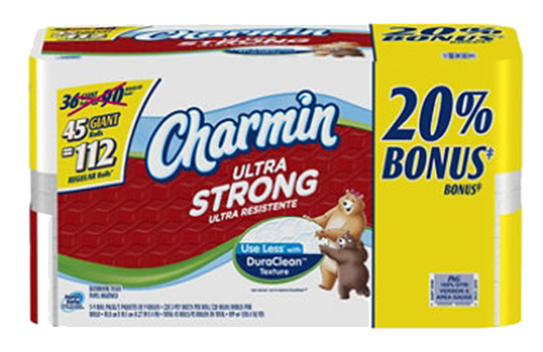
Pricing ‘added value’

Slide 11
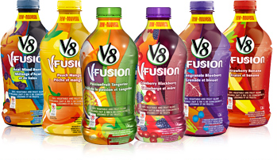
Flavour separations

Slide 12
Flavour separations

Slide 13
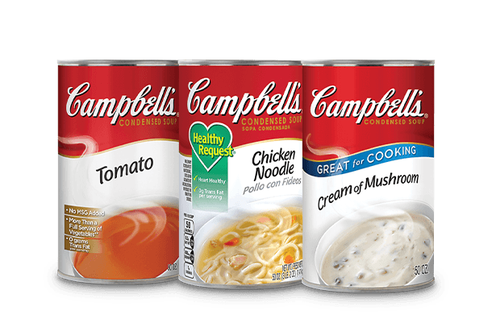
Keep line extensions distinct

Slide 14
Keep line extensions distinct

Slide 15
Uniqueness

Slide 16
Differentiate from competition

Slide 17
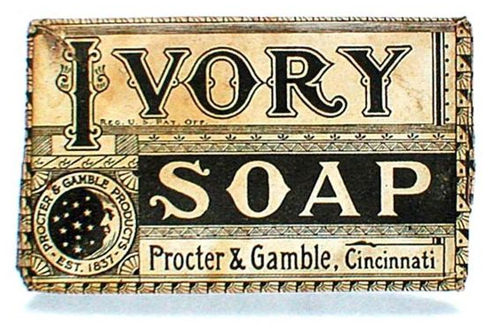
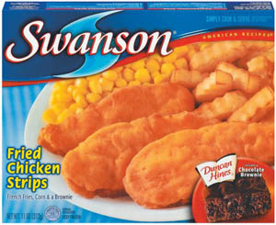
Rejuvenate brand

Slide 18
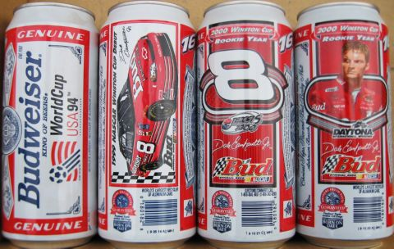
Themed or promotional

Slide 19
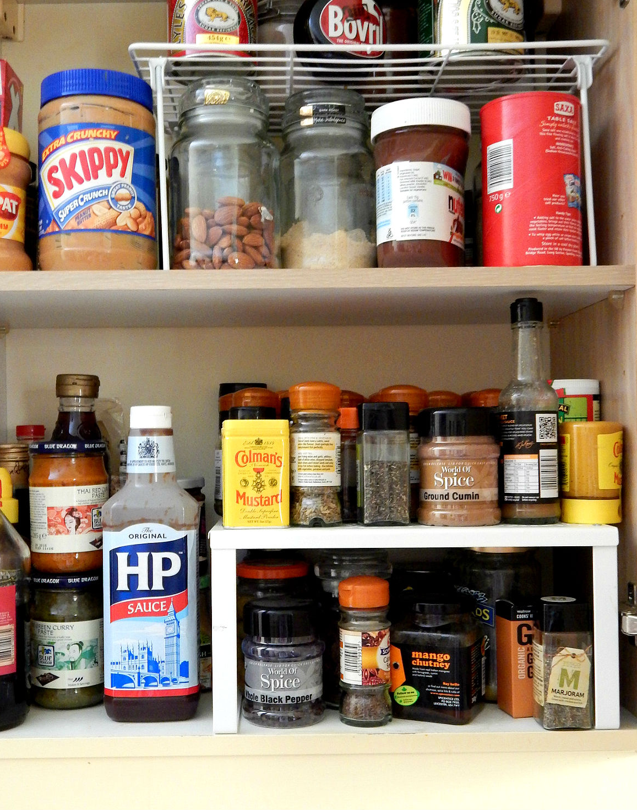
Advertising continuity

Slide 20
Labelling
Ingredients or content
Nutrition facts (calories, fat, etc.)
Bilingual
The manufacturer’s address and toll-free number
Website
Preparation & Care instructions
Suggestions or use (such as recipes)

