Slide 1
An Introduction to Marketing

Slide 2
What is marketing?

Slide 3
Marketing is the act of changing the way people think...their
attitudes
opinions
behaviours
preferences
beliefs
motivations

Slide 4
For example...
Buy my product
Save the environment
Don’t drink and drive
Look young again
Please donate
Vote for me
Get vaccinated
Like my page

Slide 5
PERSUASION

Slide 6
Consumer Marketing
The activities that companies take to promote the buying or selling of a product or service
Products and Services

Slide 7
Consumer Marketing
The process of
understanding consumers wants and needs,
engineering your business to meet these needs, and
using persuasive tactics to motivate transactions
Products and Services

Slide 8
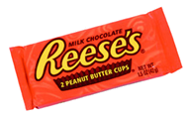
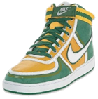
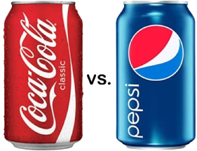
Marketing Process
Find out what customers want and/or need
Fully understand the industry (size, trends, competition, etc.)
Fully understand the macro-environment (political, economic, etc.)
Develop your product or service
Launch and market it
Evaluate your efforts and make adjustments

Slide 9
Marketing Research

Slide 10
NEEDS AND WANTS
DEMANDS
FOR PRODUCTS AND SERVICES

Slide 11
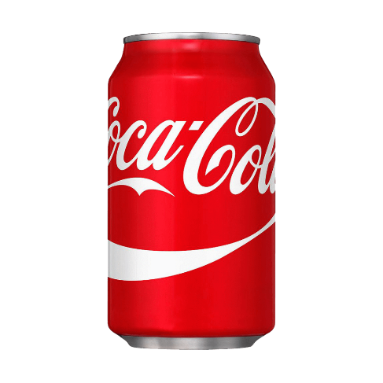
NEEDS AND WANTS
PRODUCTS & SERVICES

Slide 12
Consumers are not HOMOGENOUS

Slide 14
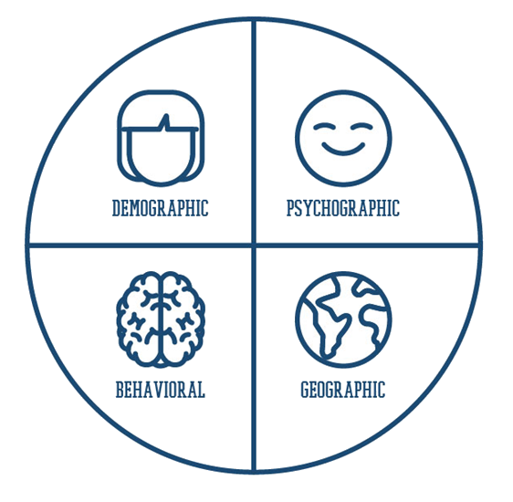

Slide 15
Single segment Approach

Slide 16
Multisegment Approach

Slide 17
The Evolution of Marketing
The Production Era
Mass production of goods with no customization
The Sales Era
Hard selling to consumers to outsell competition
The Marketing Era
Find put what consumers want and deliver it
Differentiate your product/service
Societal Marketing Era
Social considerations
Environmental considerations

Slide 18
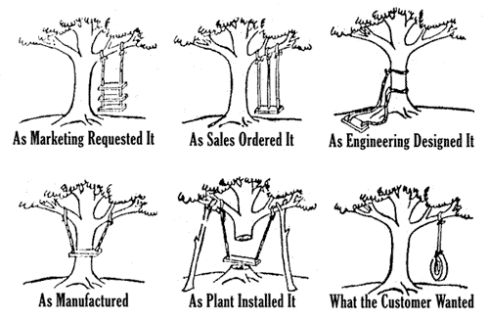
Consumer Centric

Slide 19
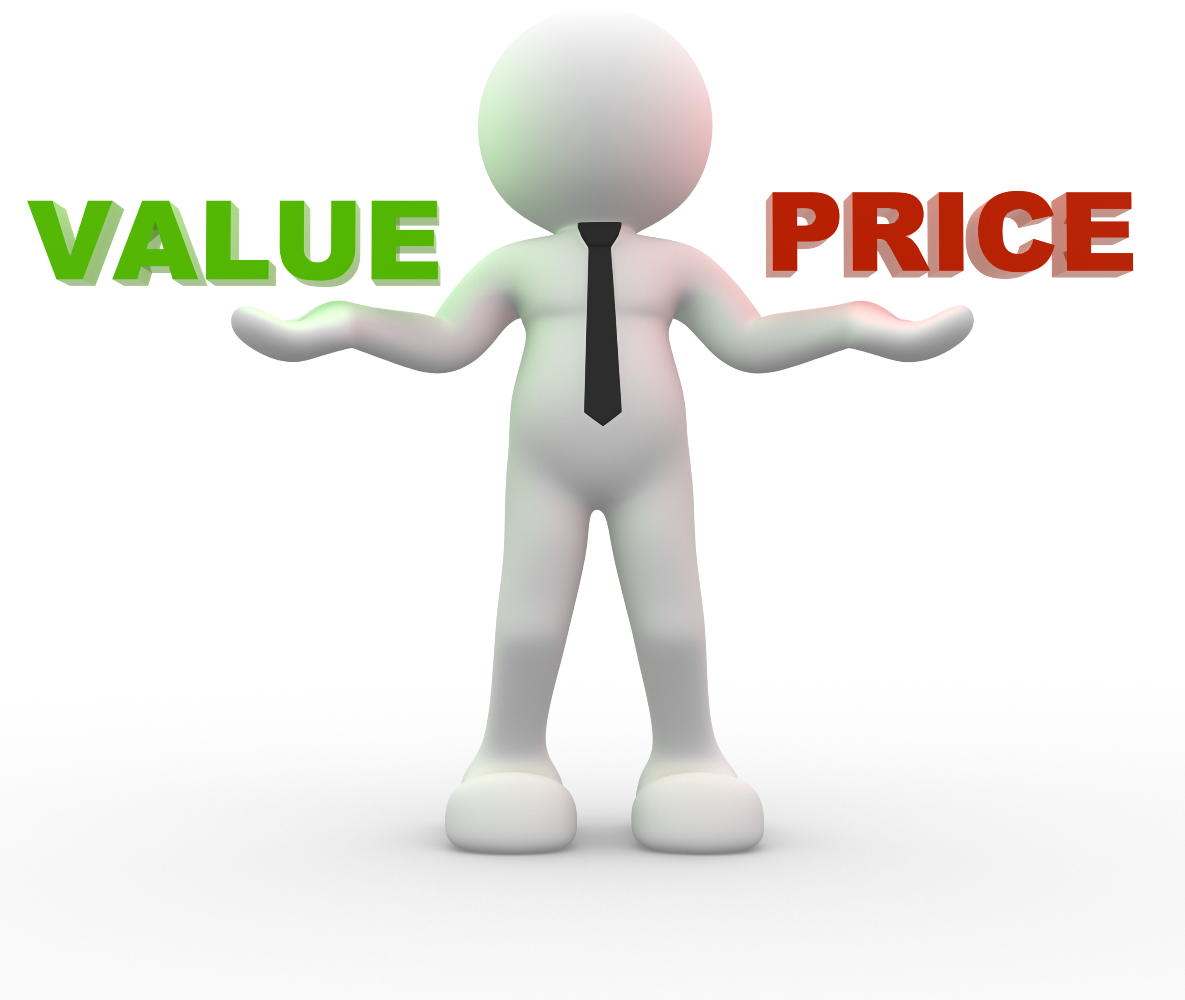
Exchange Value
Value in exchange for price
Use Value
Value in terms of usefulness
Symbolic Value
Emotion, image, identity, social status

Slide 20
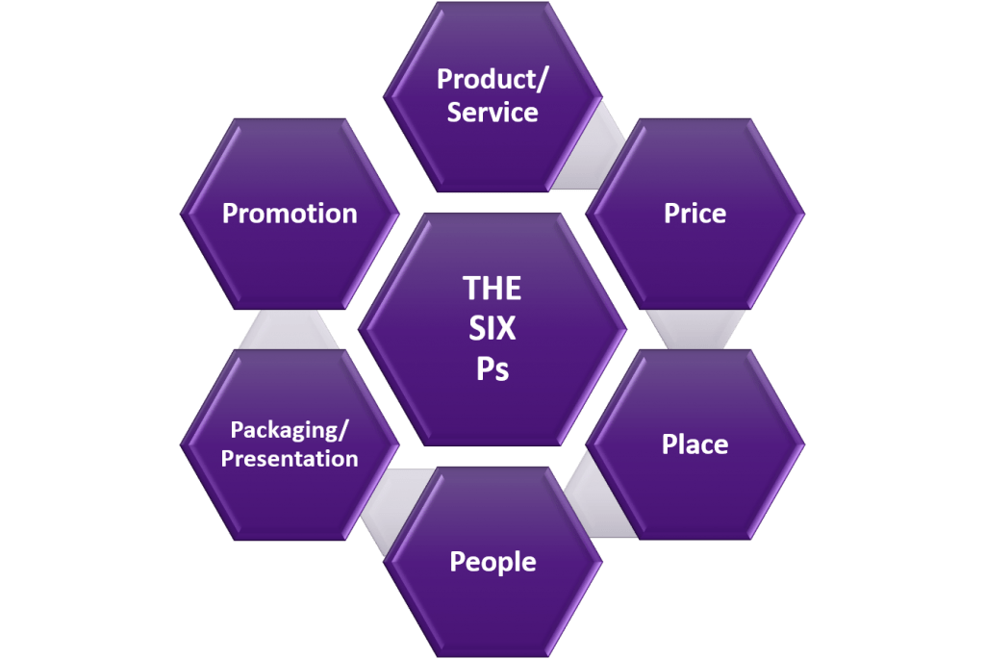
The
Marketing
Mix

Slide 21
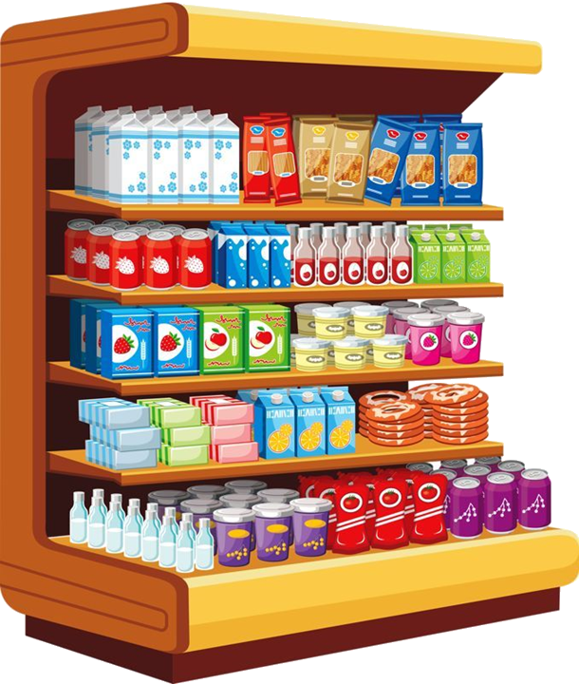
Front line tactics
Online tactics
(in the physical world)
(in the virtual world)

Slide 22
As a marketer, how will you evaluate success?

Slide 23
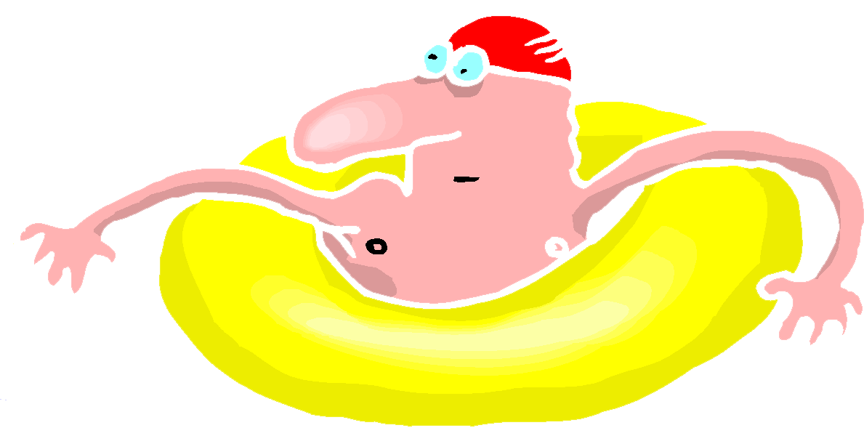
HINT: a measure of our marketing success
(as determined by the consumer)
S A T I S F A C T I O N

Slide 24
Other measures of success…
Volume
Profit
Market share
Repeat purchases
Frequency of purchase
Loyalty and retention
Marketing investment ROI
“If you can’t measure it, you can’t manage it!”

Slide 25
Summary: Consumer Marketing
Find out what customers want and/or need
Fully understand the industry (size, trends, competition, etc.)
Fully understand the macro-environment (political, economic, etc.)
Develop your product or service
Launch and market it
Evaluate your efforts and make adjustments

