Slide 2
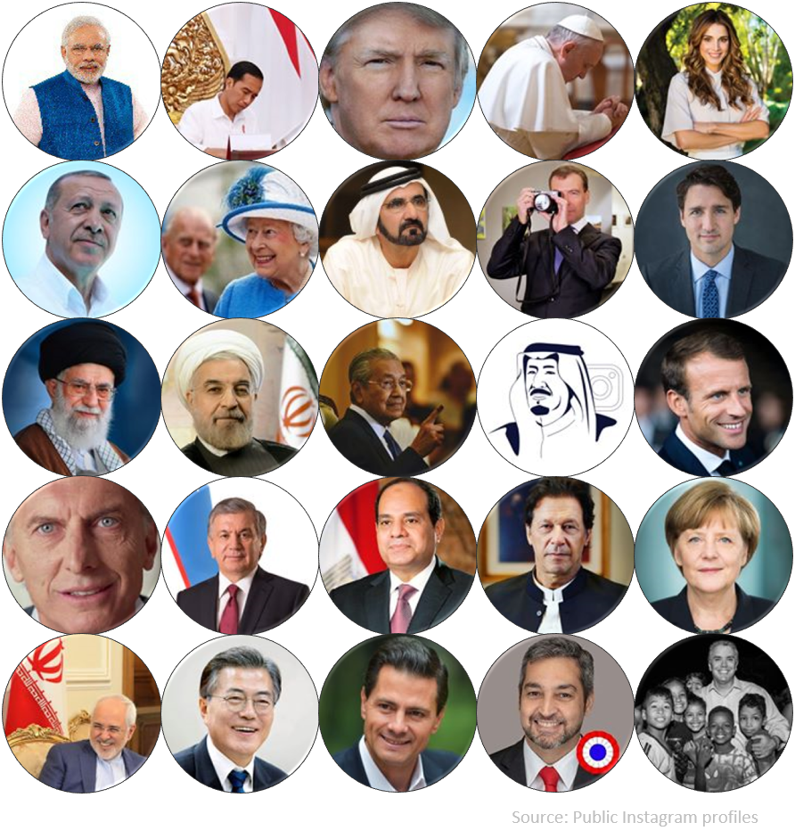
People remember great leaders

Slide 3
and people remember successful entrepreneurs

Slide 4
But nobody glorifies great managers!

Slide 5
Notes:
Do not modify the notes in this section to avoid tampering with the Poll Everywhere activity. More info at polleverywhere.com/support LiveSlide https://jamboard.google.com/d/1ItNGKD910-xeoh-WhlimZCy--jki-Mxz5foUhmieHJ8/edit?usp=sharing

Slide 6
LEADERSHIP
MANAGEMENT
THE FUTURE:
Find and develop opportunities
Prepare for the future
Inspire with a vision
Manage change
Create change
Medium & long term
THE PRESENT:
Efficiently operate to maximize profitability
Plan to achieve goals
Organize resources
Implement & motivate
Evaluate & adjust
Short & medium term
Manage the present.
Lead into the future.

Slide 7
LEADERSHIP
MANAGEMENT
THE FUTURE:
Find and develop opportunities
Prepare for the future
Inspire with a vision
Manage change
Create change
Medium & long term
THE PRESENT:
Efficiently operate to maximize profitability
Plan to achieve goals
Organize resources
Implement & motivate
Evaluate & adjust
Short & medium term
Dreamers and Doers

Slide 8
Acting with your HEAD and your HEART
HEAD
HEART

Slide 11
Why Is It Important?

Slide 12
Daily
Weekly
Monthly
Scheduling
Logistics
Analysis
Decision making
To achieve goals and objectives
THE DEVIL IS IN THE DETAILS

Slide 14
What resources do we manage?

Slide 15
One word or hyphenated answers please!
Notes:
Poll Title: Do not modify the notes in this section to avoid tampering with the Poll Everywhere activity. More info at polleverywhere.com/support What resources do we manage? https://www.polleverywhere.com/free_text_polls/GpVNS62MaCReoWWD6H67y

Slide 16
IMPLEMENT

Slide 17
PRODUCTIVITY

Slide 18
PRODUCTIVITY
EFFICIENCY
(maximize quantity)
&
EFFECTIVENESS
(maximize quality)

Slide 20
Conflict
Need for SOPs, routines and consistency
Need to be responsive, to change

Slide 22
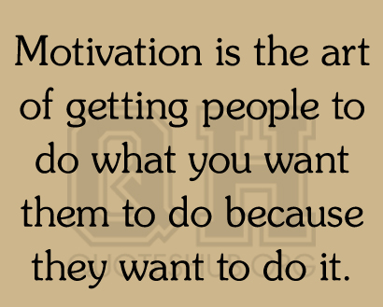
The Business Perspective

Slide 24
Notes:
Poll Title: Do not modify the notes in this section to avoid tampering with the Poll Everywhere activity. More info at polleverywhere.com/support How can we motivate employees? https://www.polleverywhere.com/free_text_polls/bxiDmPqRvK56EHXSXO3oA

Slide 26
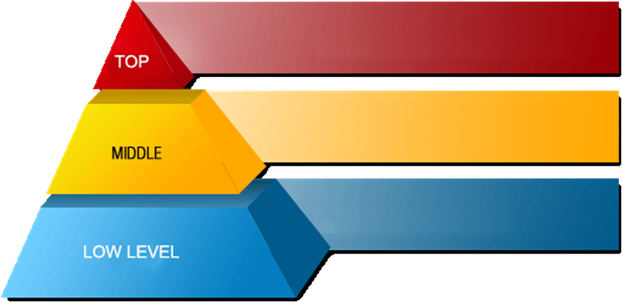
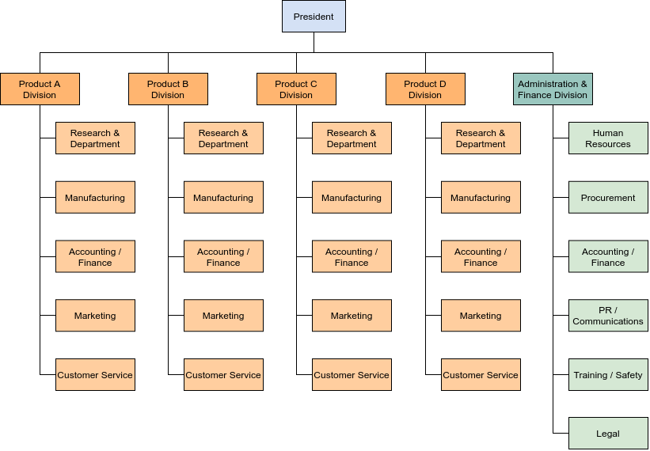

Slide 27
LEVELS
OF
MANAGEMENT

Slide 28
Levels of Management
Leaders
Long term
Medium term
Short term

Slide 29
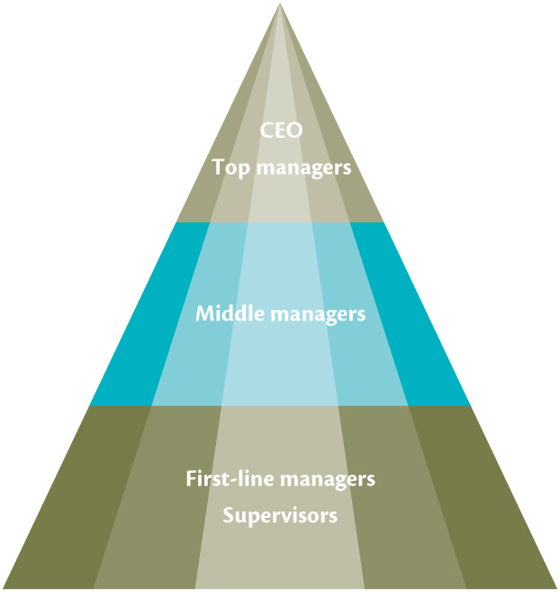
Functional
Levels Of
Management
Sales
Human
Resources
Finance
Marketing
Operations

Slide 30
Leadership

Slide 34
The Importance of Vision
Links the present to the future
Energizes people and focuses attention
Provides focus, direction
Gives meaning to work
Inspires and inspires confidence
Establishes a standard of excellence and integrity

Slide 35
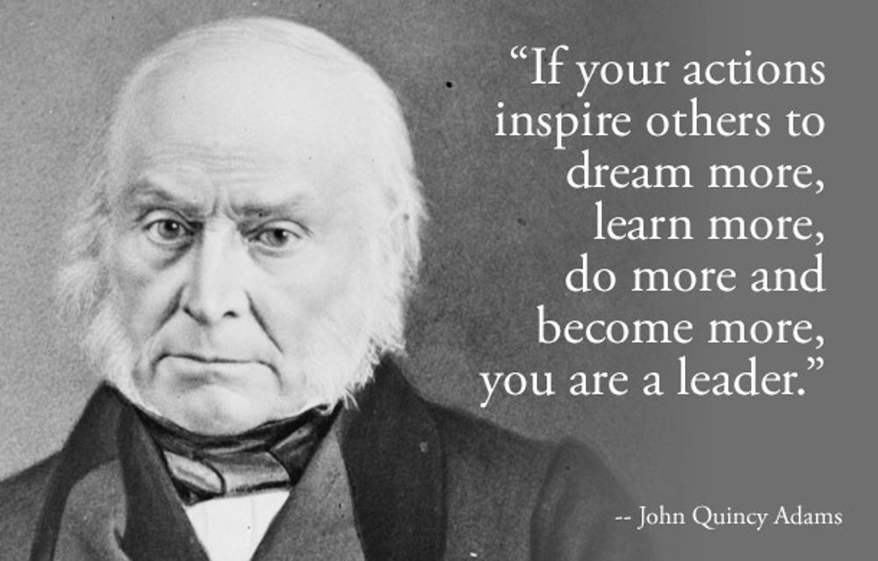

Slide 36
Notes:
Poll Title: Do not modify the notes in this section to avoid tampering with the Poll Everywhere activity. More info at polleverywhere.com/support How would you describe a great leader? https://www.polleverywhere.com/free_text_polls/QNTOil3OyNkhxxODlBdeE

Slide 38
In reality, there are two other important considerations:
The quality of your ‘followers’ (staff, volunteers, etc.)
The situation

Slide 39
The quality of your ‘followers’
Able and willing or confident followers (lots of skill AND motivation)
Able BUT unwilling or insecure followers (lots of skill BUT lack motivation)
Unable but willing or confidant followers (lack the skill but are highly motivated)
Unable AND unwilling or insecure followers (lack skill AND motivation)

Slide 40
The Situational Model of Leadership
High
Able BUT unwilling or insecure followers
PARTICIPATING
Share ideas and facilitate in decision-making
Unable but willing or confidant followers
COACHING
Explain decisions and provide opportunity for clarification
Relationship Behaviour (support)
Able and willing or confident followers
DELEGATING
Turn over responsibility for decisions and implementation
Unable AND unwilling or insecure followers
TELLING
Provide specific instructions and closely supervise performance
Low
Task Behaviour (guidance)
High

Slide 41
Delegation
Crisis/emergency
HIGH importance
Lots of time
Urgent/very little time
LOW importance
Authoritarian
The situation may or may not be time sensitive (lots of time vs urgent/very little time)
The situation may vary in IMPORTANCE (how high are the stakes?)
Is this a crisis or emergency? (combination of the above)

Slide 42
HARD
POWER
SOFT
POWER
Position Power, authoritative
Persuasion, interpersonal

Slide 45
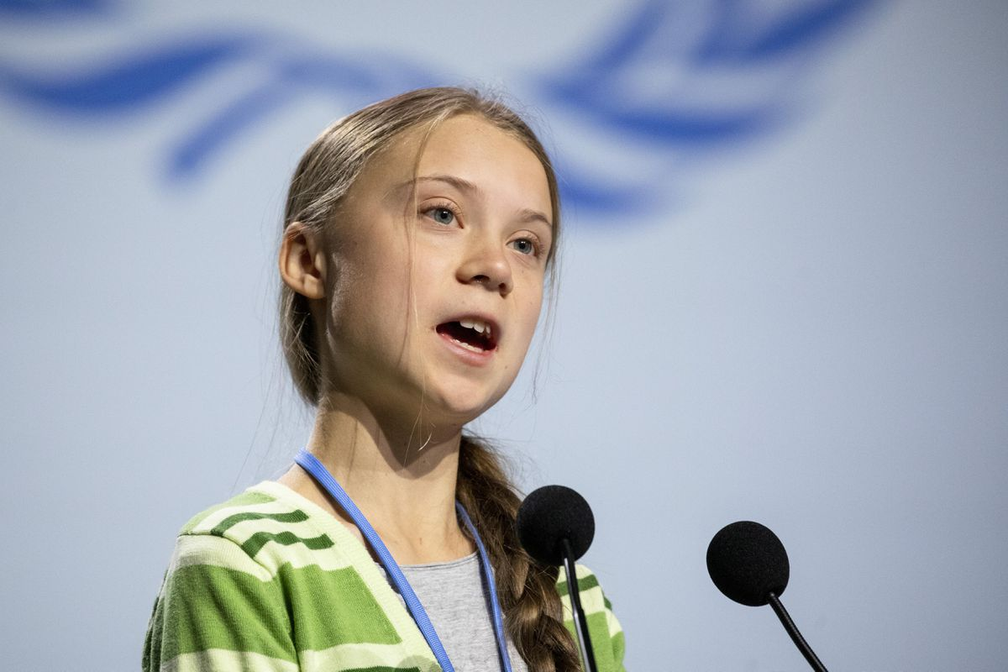
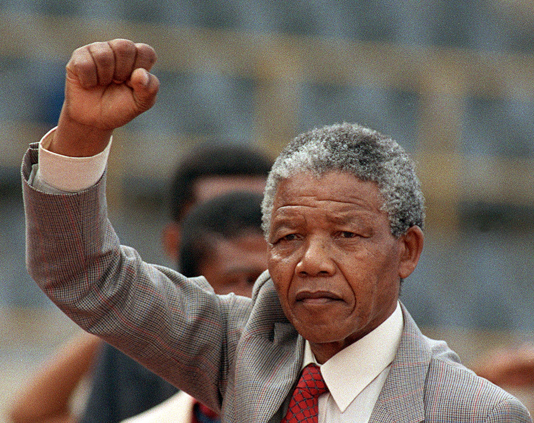
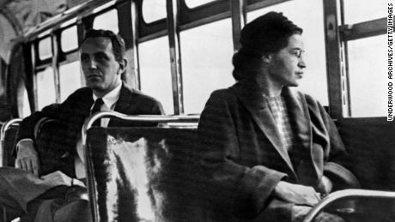
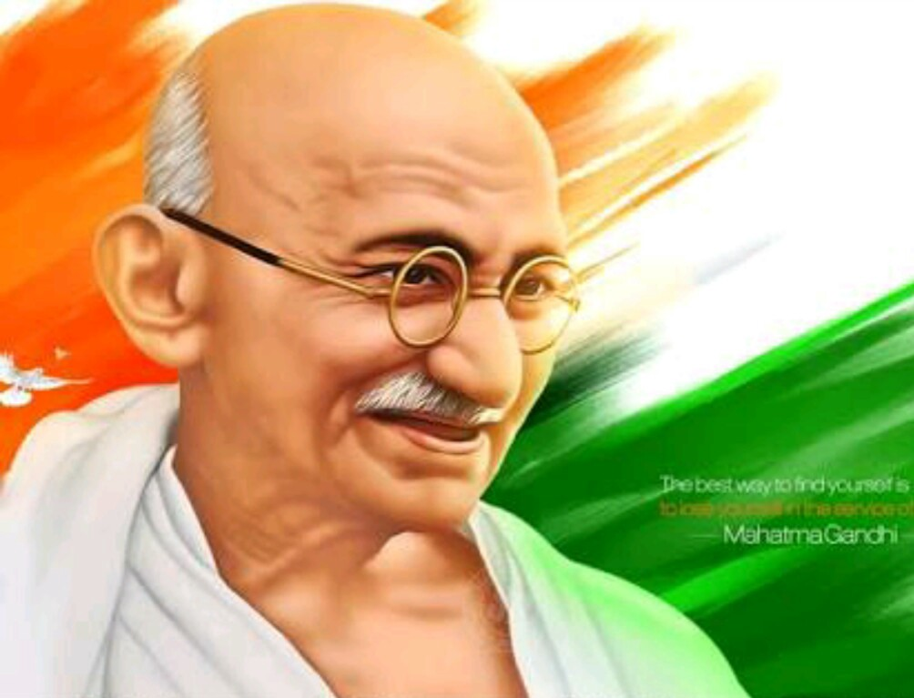
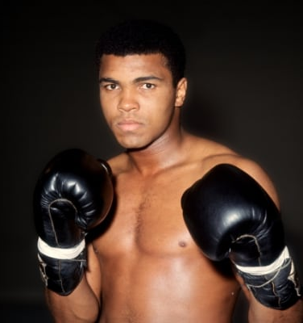
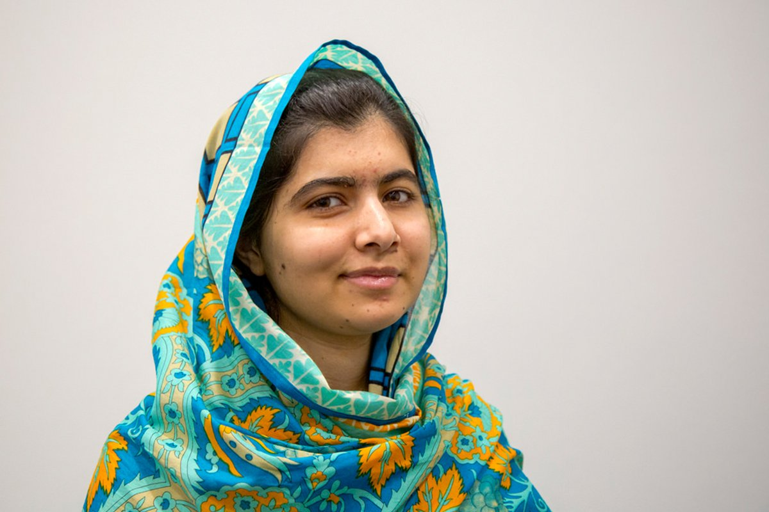
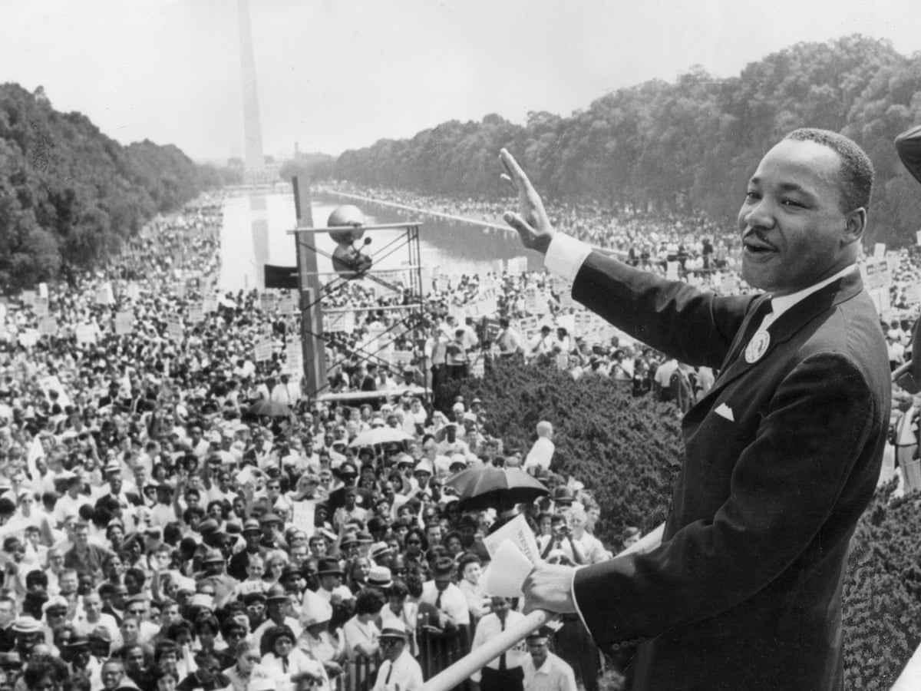
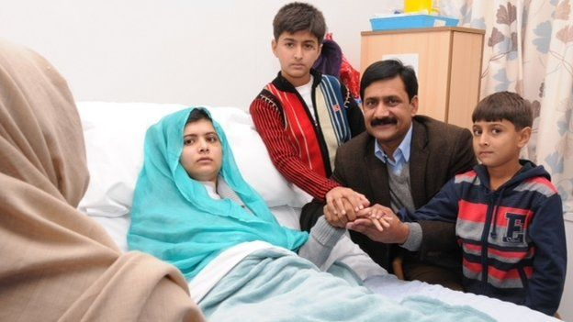

Slide 47
