Slide 1
Post-secondary Student Preparation

Slide 3
Today’s Objective:
Set you up for success!
Tips and advice on
Creating reports
File management
Time management
Group activities (time permitting)

Slide 5
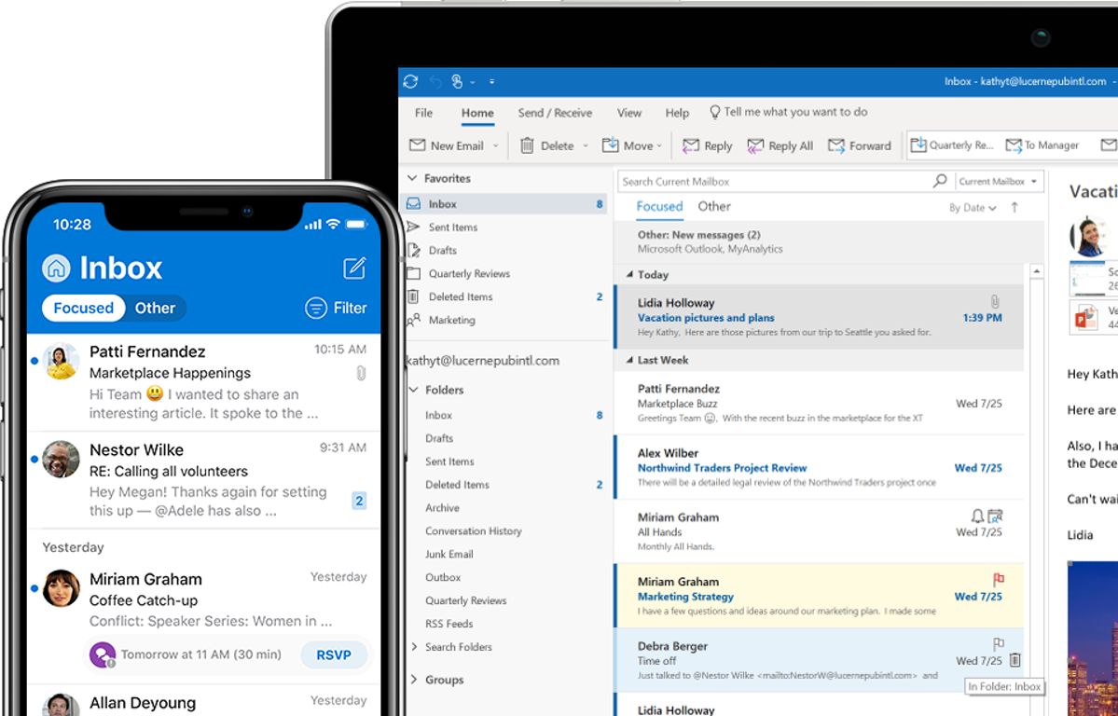
It’s important to use your
student email account!
Support Link

Slide 7
Use Word’s cover pages
Support Link

Slide 8
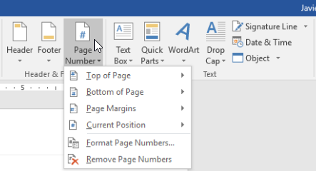
Use Word’s automatic
page numbering
Best format is ‘Page x of y’ (example: Page 2 of 8)
Support Link

Slide 9
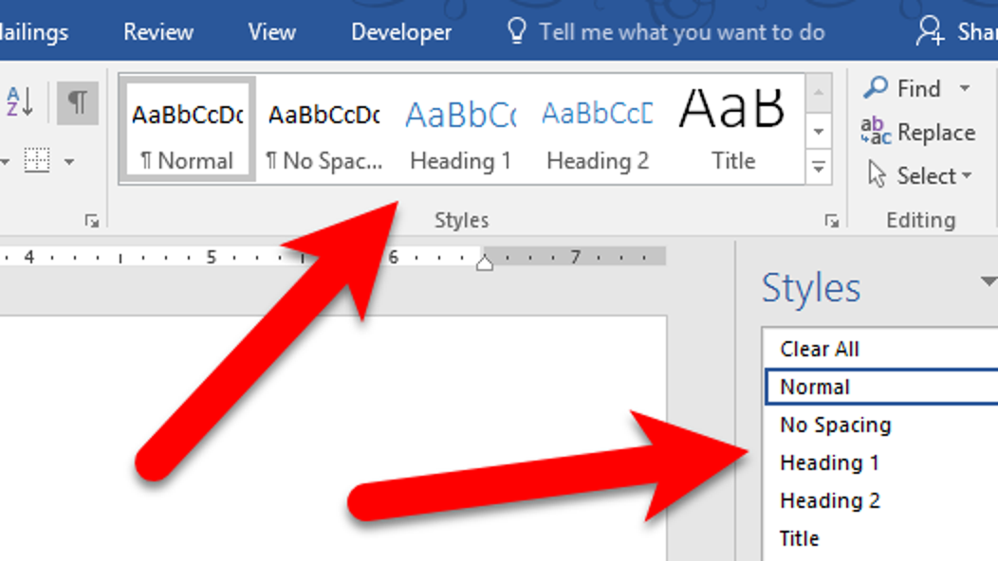
Use Heading Styles for your titles
You can customize them
Support Link

Slide 10
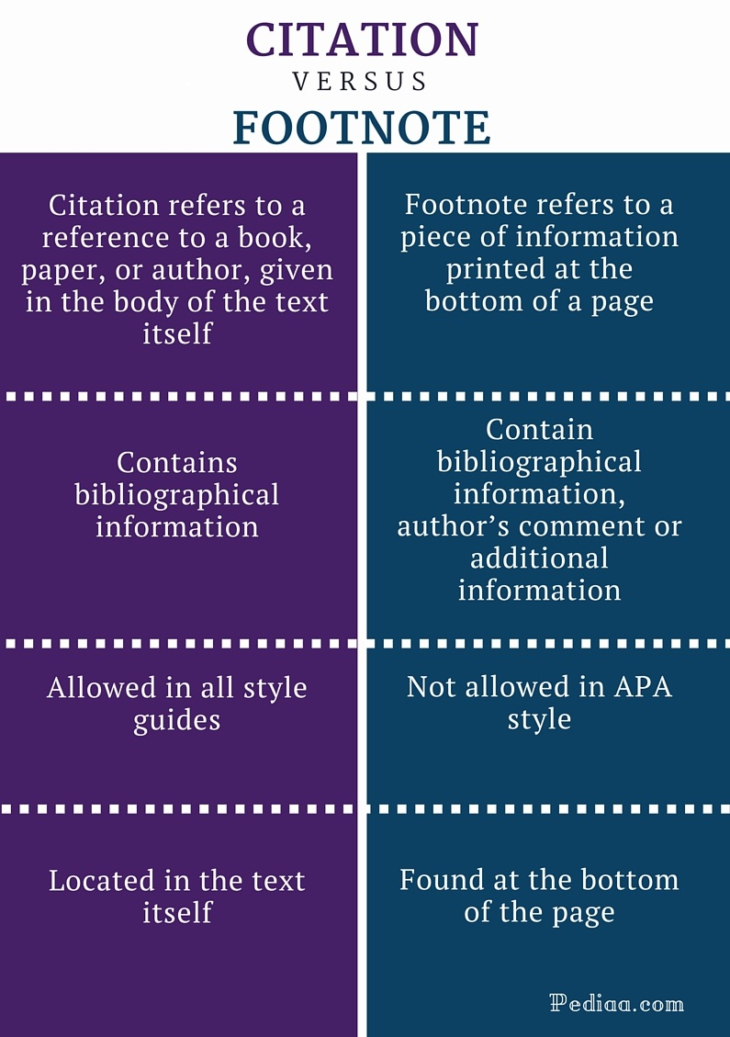

Slide 11
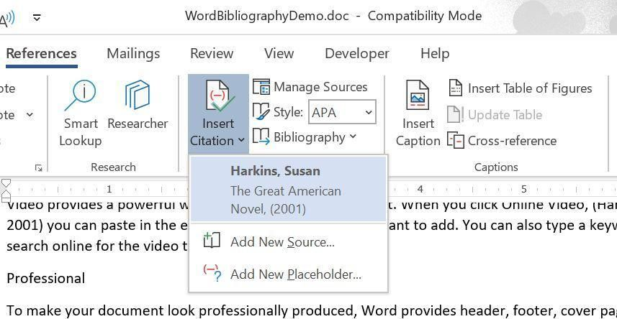
Support Link
Use Word to insert your Citations

Slide 12
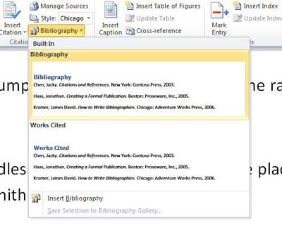
Use Word’s Bibliography
It links to your Citations!
Support Link

Slide 13
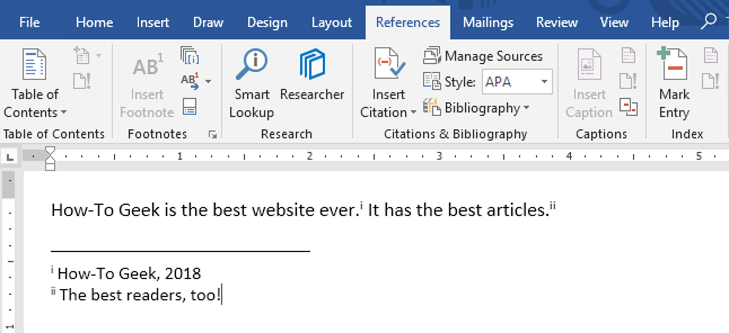
Support Link
Use Word to insert your Footnotes

Slide 14
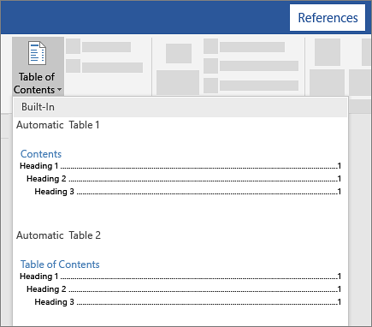
Use Word’s Table of Contents
It links to your Heading Styles and Page Numbers!
Support Link

Slide 15
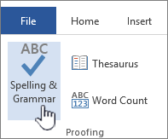
Use Word’s Spelling & Grammar
Support Link

Slide 16
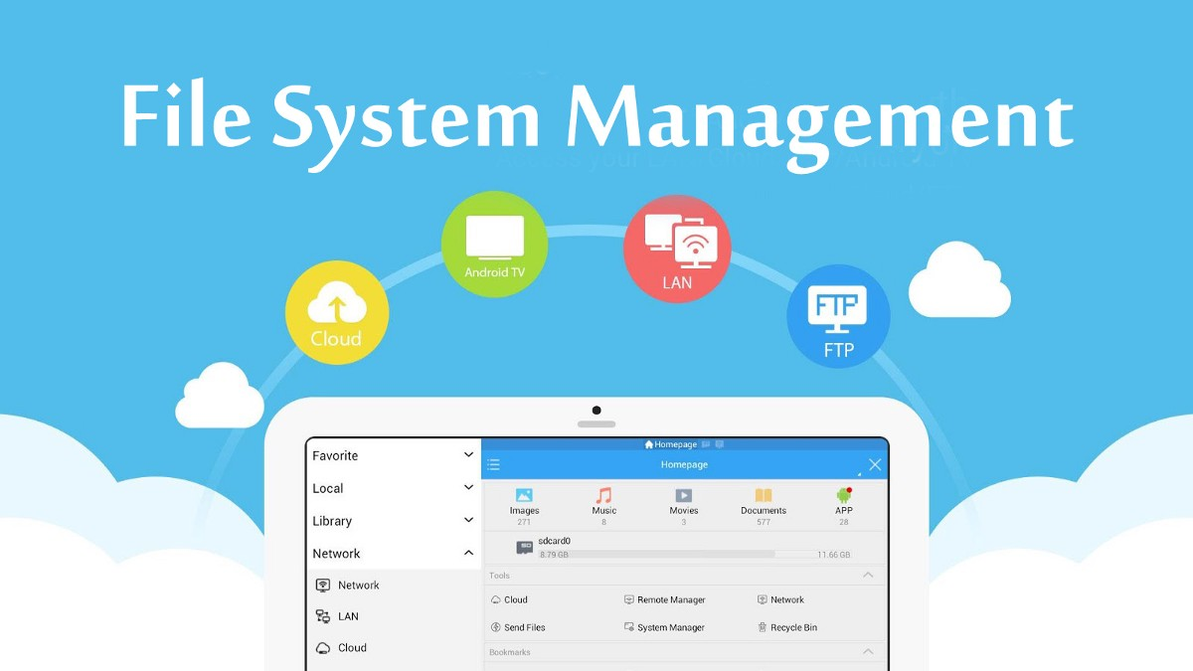

Slide 17
File Folder Management
Use your OneDrive to backup your files!
Create a folder per course
You may need sub-folders per course
Use descriptive file names
Support Link

Slide 18
Time Management

Slide 19
Why is Time Management important?
What are the negative consequences of bad time management?
What are the positive benefits of great time management?

Slide 20
To Do Lists (Checklists)
So we don’t forget!
So we can organize our tasks
Organizing relieves stress
So we can priorize our tasks
So we can schedule our tasks
So we can delegate (where appropriate)
So we can manage expectations

Slide 21
Urgent and
Important
Not Urgent
but
Important
Urgent
but not
Important
Not Urgent
and not
Important

Slide 22
We tend to do the easy and/or enjoyable!
Urgent and
Important
Not Urgent
but
Important
DO FIRST
DO NEXT
Urgent
but not
Important
Not Urgent
and not
Important
DELEGATE
ELIMINATE

Slide 23
Scheduling Your Time
Plan the URGENT and IMPORTANT first
Plan the IMPORTANT but not URGENT second
Schedule them early
Allow ample time

Slide 24
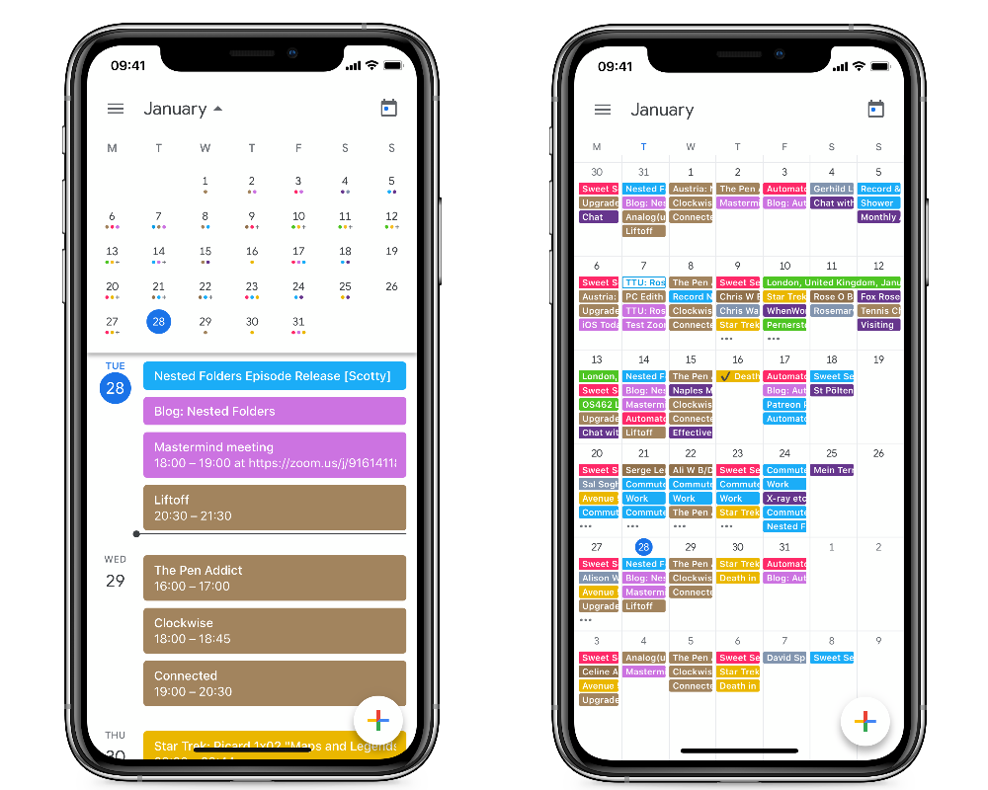
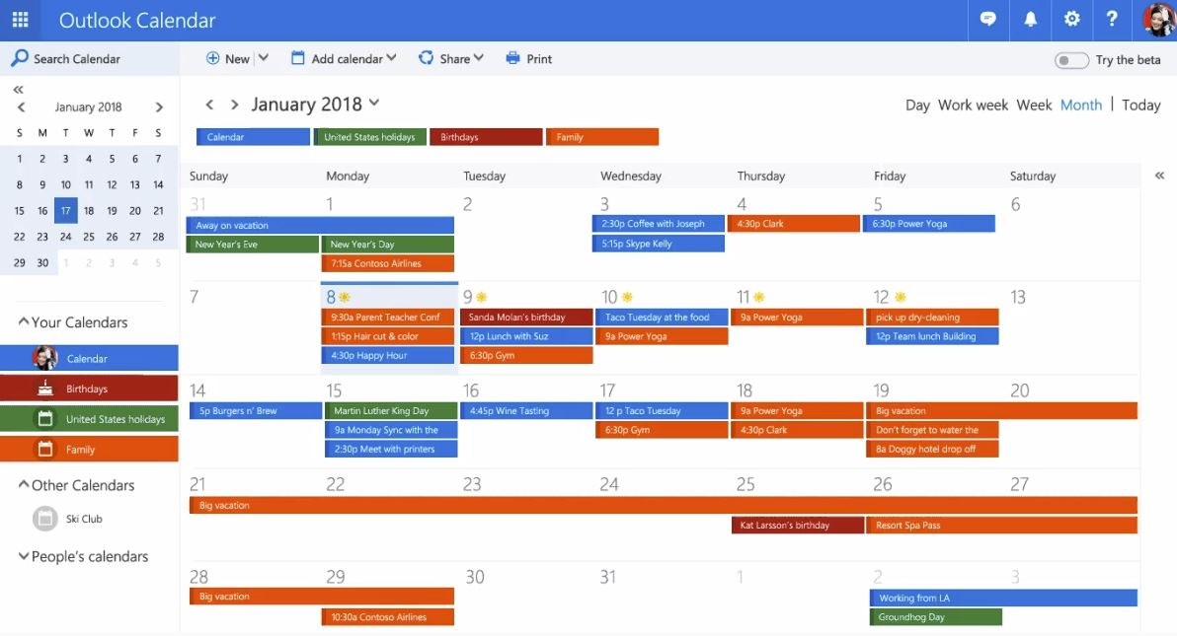
Digital Calendar
Support Link

Slide 25
Minimizing Distractions

Slide 28
BREAK THE
ADDICTION

